Slide 1
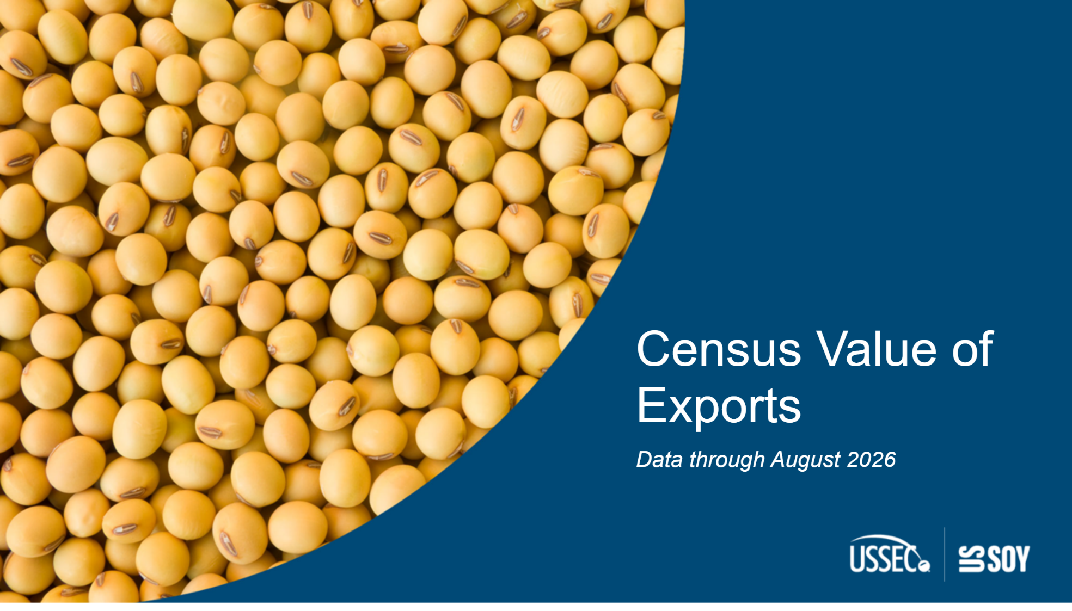
Cover
Notes:
textbox
No alt text provided

Slide 2
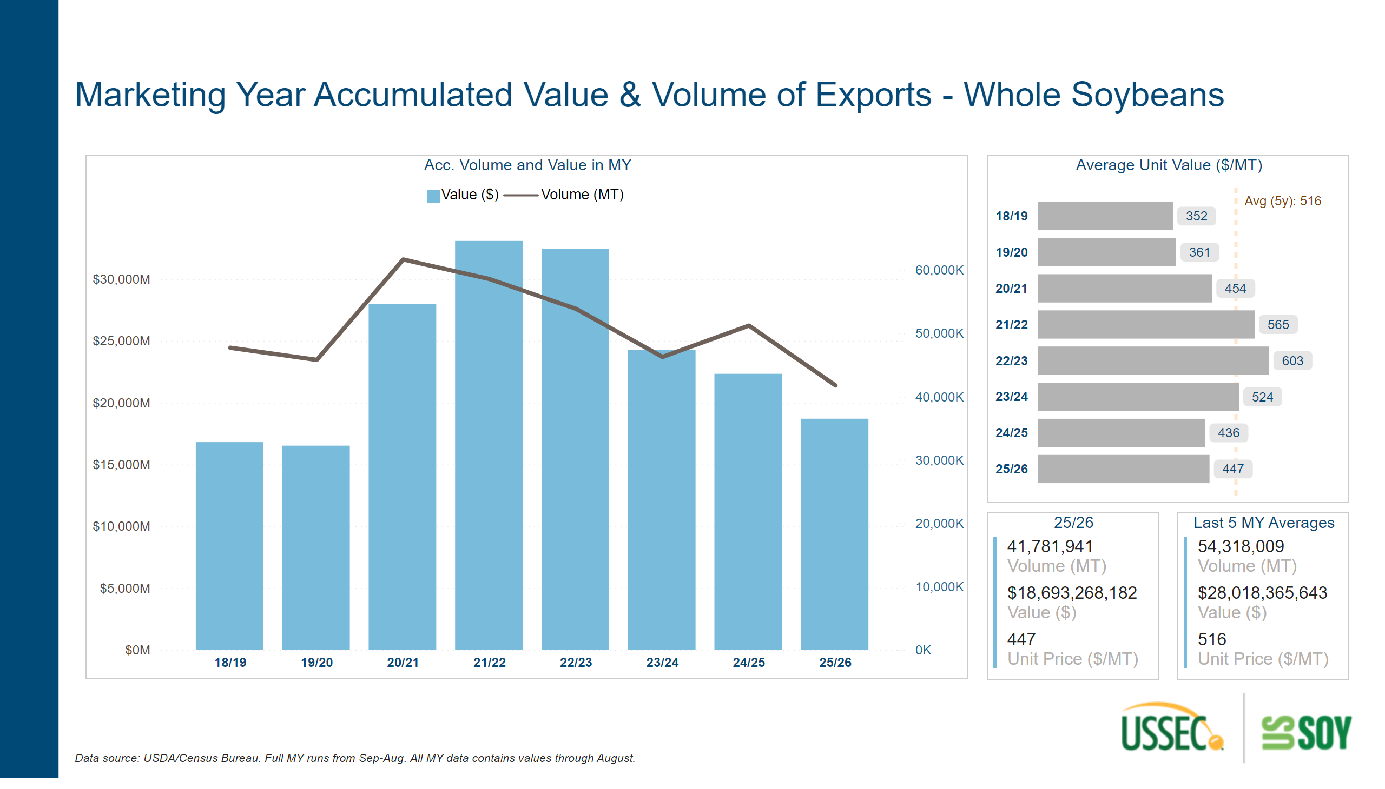
Export/Value Mkt Year SB
Notes:
Last 5 MY Averages
No alt text provided
Acc. Volume and Value in MY
No alt text provided
textbox
No alt text provided
shape
No alt text provided
textbox
No alt text provided
Average Unit Value ($/MT)
No alt text provided
25/26
No alt text provided

Slide 3
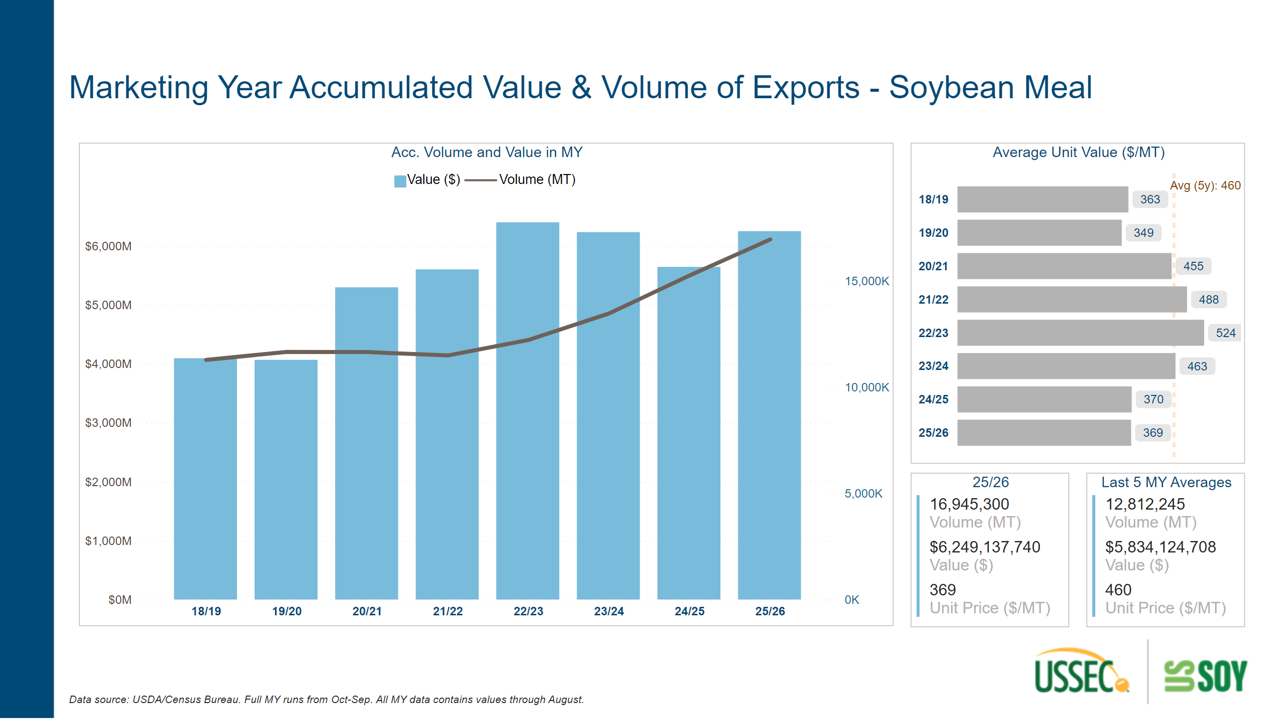
Export/Value Mkt Year SBM
Notes:
textbox
No alt text provided
Last 5 MY Averages
No alt text provided
Average Unit Value ($/MT)
No alt text provided
textbox
No alt text provided
25/26
No alt text provided
Acc. Volume and Value in MY
No alt text provided
shape
No alt text provided

Slide 4
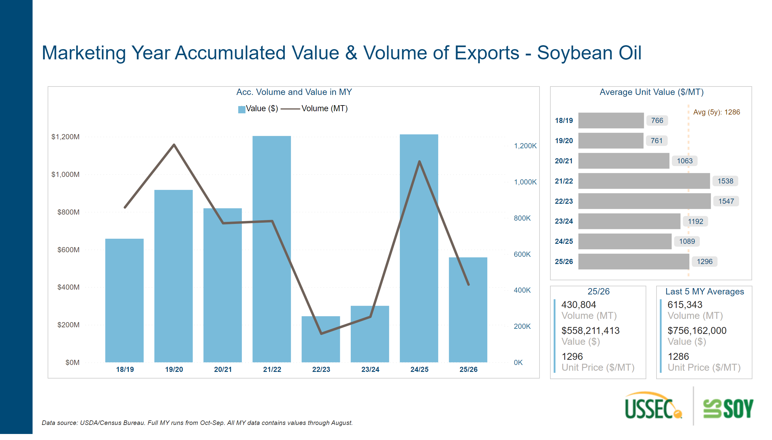
Export/Value Mkt Year SBO
Notes:
Last 5 MY Averages
No alt text provided
textbox
No alt text provided
25/26
No alt text provided
Average Unit Value ($/MT)
No alt text provided
shape
No alt text provided
textbox
No alt text provided
Acc. Volume and Value in MY
No alt text provided

Slide 5
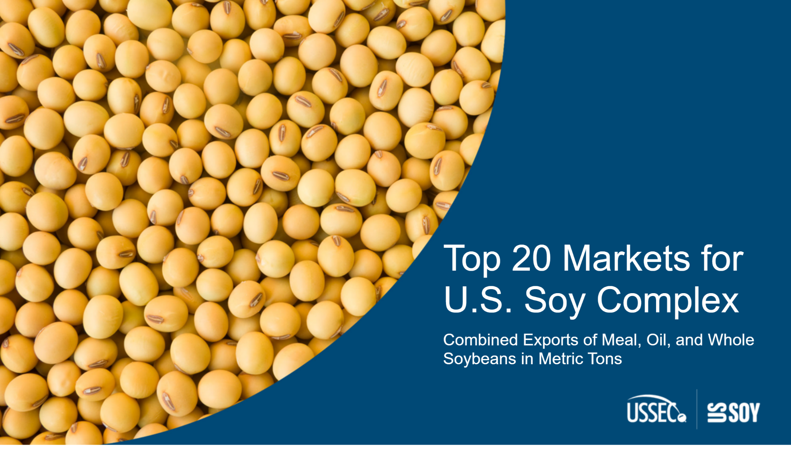
Top20Cover
Notes:
textbox
No alt text provided

Slide 6
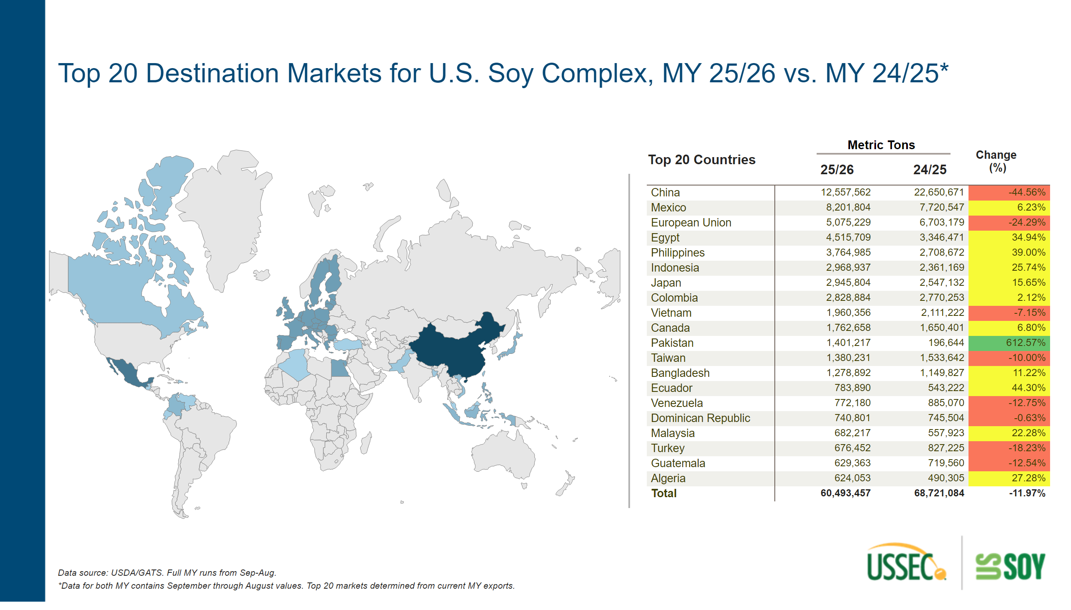
Top20 Soy Complex Markets- Map- 2Last Year
Notes:
card
No alt text provided
card
No alt text provided
shape
No alt text provided
shapeMap
No alt text provided
pivotTable
No alt text provided
card
No alt text provided
textbox
No alt text provided
slicer
No alt text provided
textbox
No alt text provided
slicer
No alt text provided
shape
No alt text provided
textbox
No alt text provided
textbox
No alt text provided

Slide 7
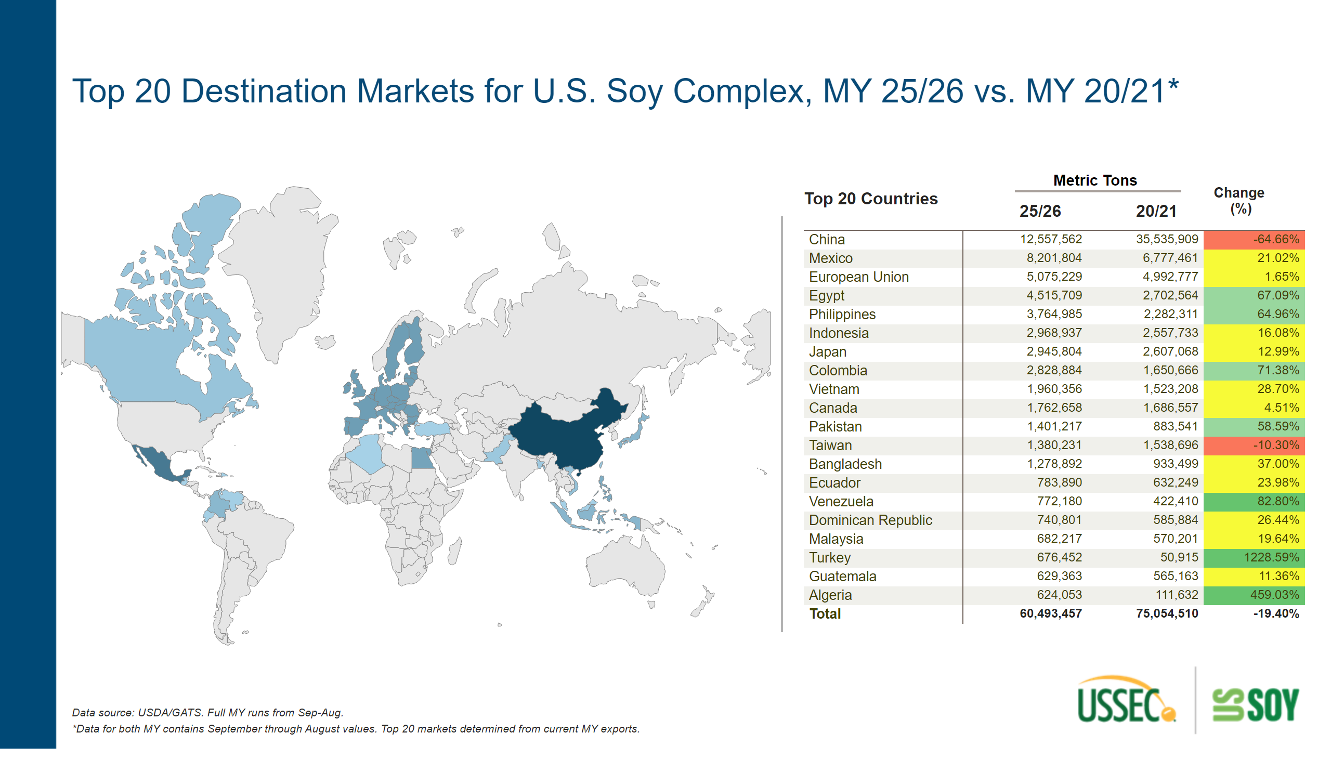
Top20 Soy Complex Markets- Map-5YA
Notes:
card
No alt text provided
textbox
No alt text provided
textbox
No alt text provided
shapeMap
No alt text provided
shape
No alt text provided
textbox
No alt text provided
textbox
No alt text provided
shape
No alt text provided
card
No alt text provided
slicer
No alt text provided
card
No alt text provided
slicer
No alt text provided
pivotTable
No alt text provided

Slide 8
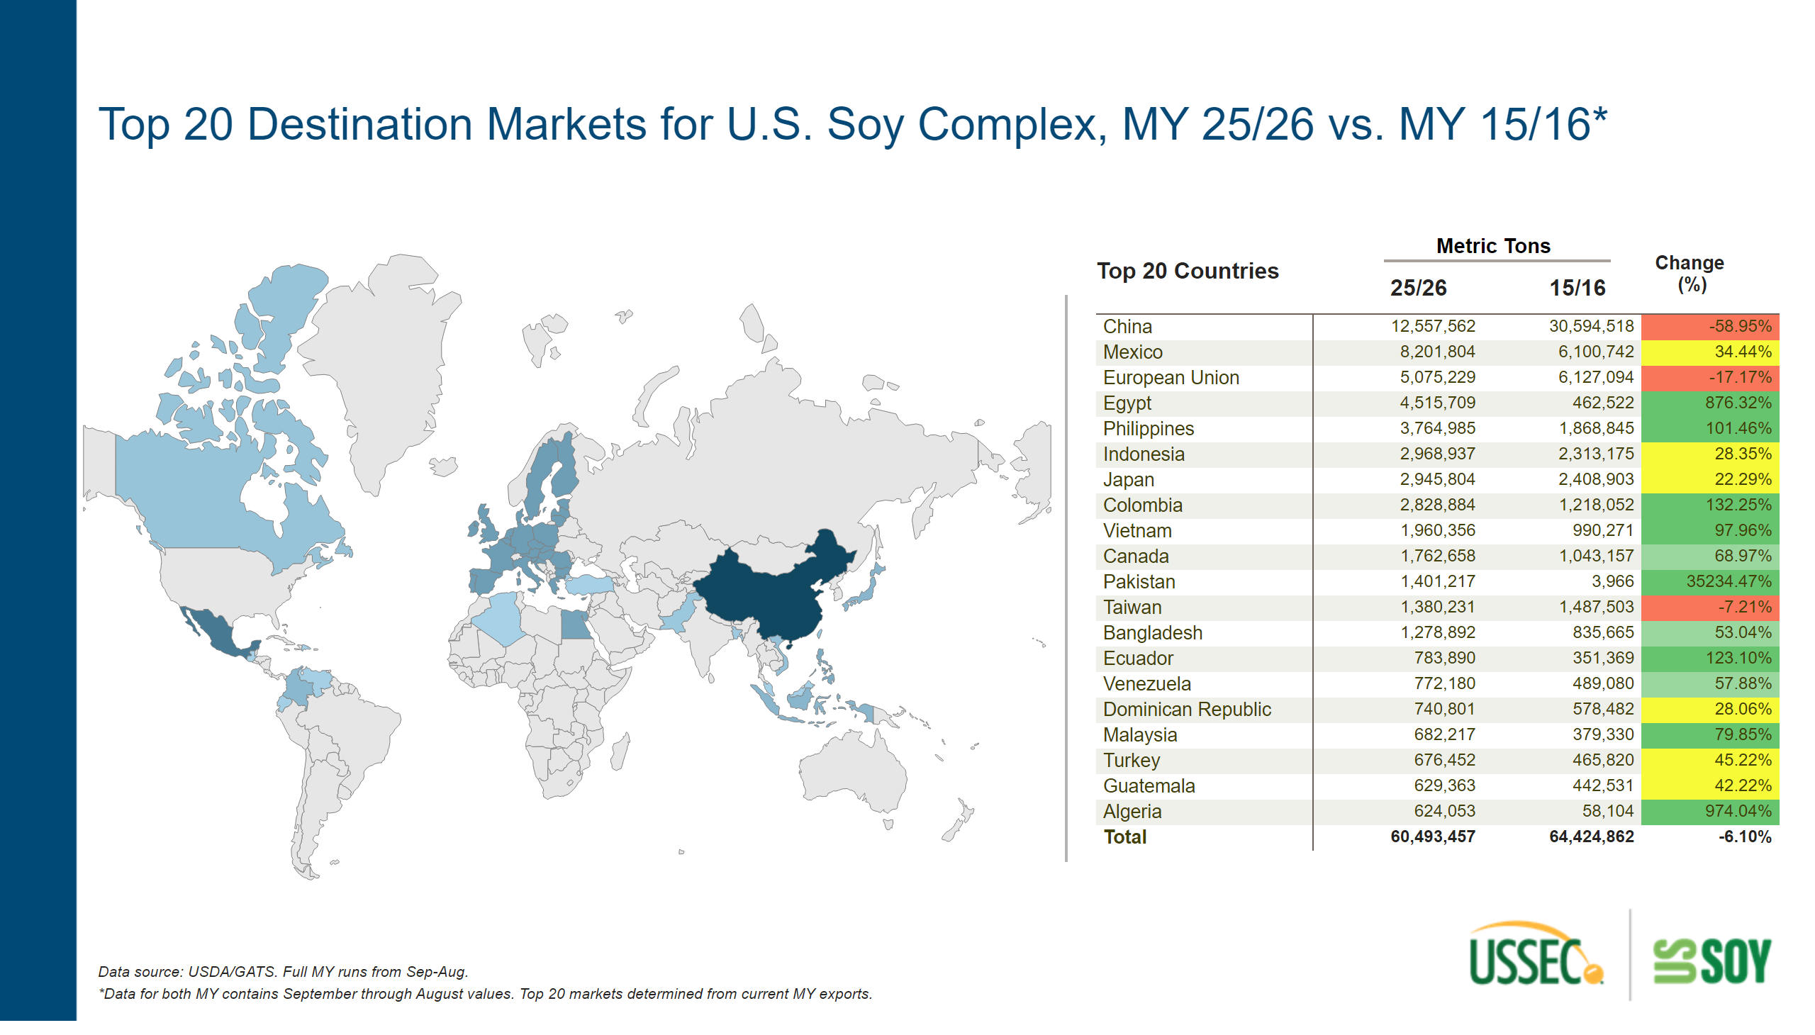
Top20 Soy Complex Markets- Map-10YA
Notes:
textbox
No alt text provided
card
No alt text provided
textbox
No alt text provided
shape
No alt text provided
textbox
No alt text provided
textbox
No alt text provided
slicer
No alt text provided
slicer
No alt text provided
card
No alt text provided
card
No alt text provided
shape
No alt text provided
shapeMap
No alt text provided
pivotTable
No alt text provided

Slide 9
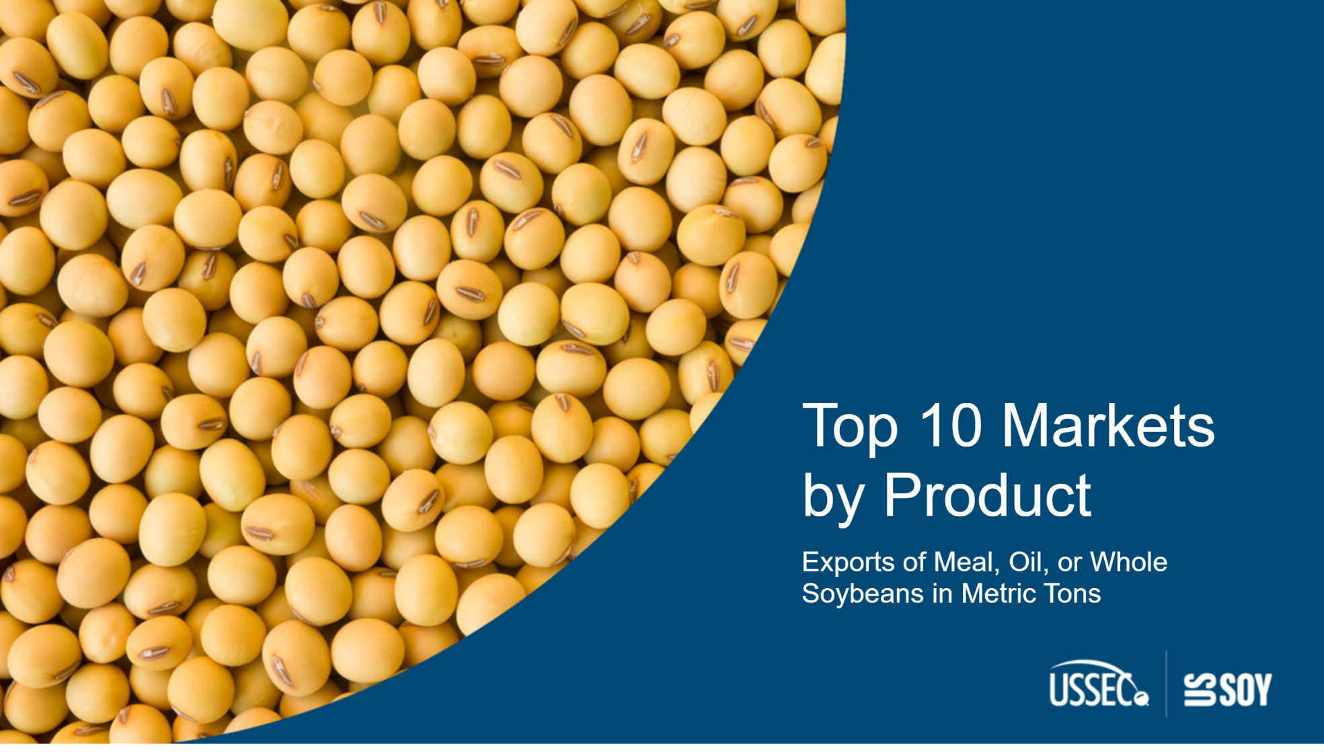
Top10Cover
Notes:
textbox
No alt text provided

Slide 10
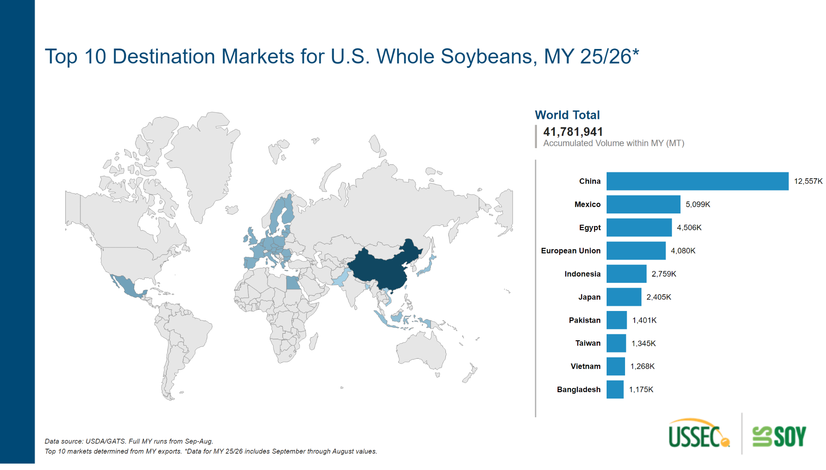
Top 10 Product Markets - Maps - SB
Notes:
slicer
No alt text provided
clusteredBarChart
No alt text provided
shape
No alt text provided
textbox
No alt text provided
shapeMap
No alt text provided
World Total
No alt text provided
textbox
No alt text provided

Slide 11
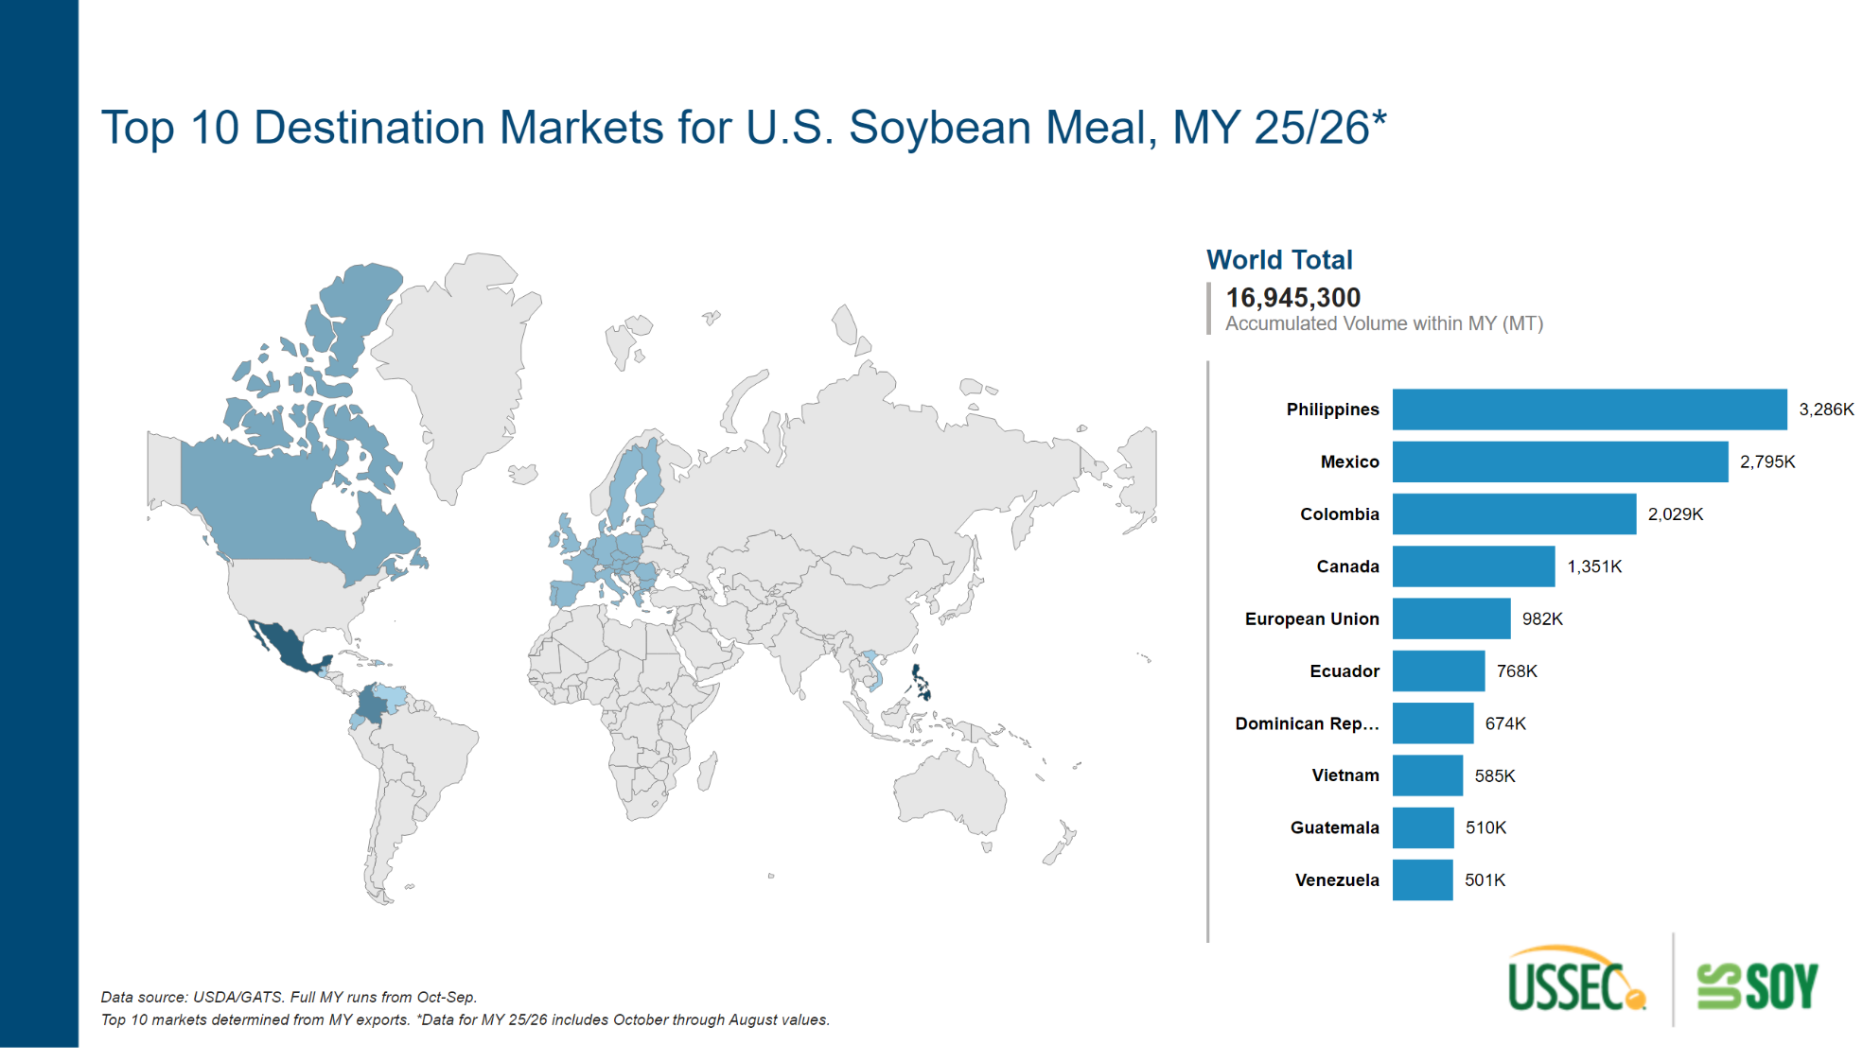
Top 10 Product Markets - Maps - SBM
Notes:
slicer
No alt text provided
shape
No alt text provided
textbox
No alt text provided
shapeMap
No alt text provided
clusteredBarChart
No alt text provided
textbox
No alt text provided
World Total
No alt text provided

Slide 12
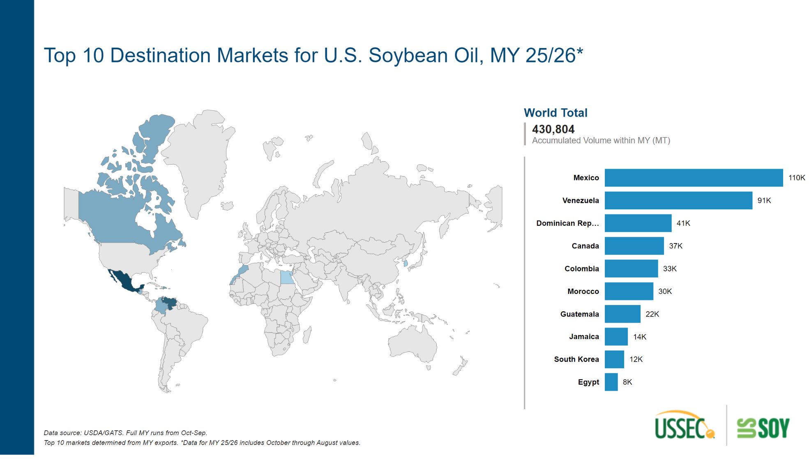
Top 10 Product Markets - Maps - SBO
Notes:
textbox
No alt text provided
clusteredBarChart
No alt text provided
slicer
No alt text provided
shape
No alt text provided
textbox
No alt text provided
shapeMap
No alt text provided
World Total
No alt text provided

Slide 13
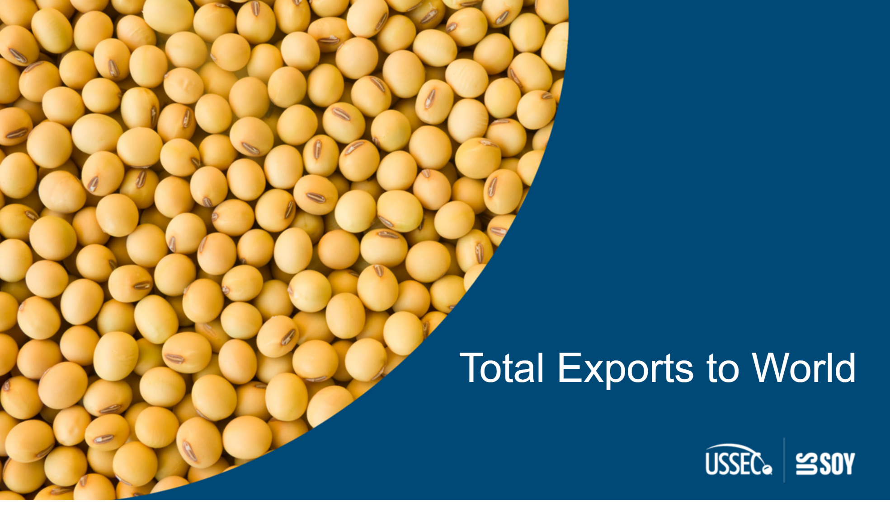
ExportsCover
Notes:
textbox
No alt text provided

Slide 14
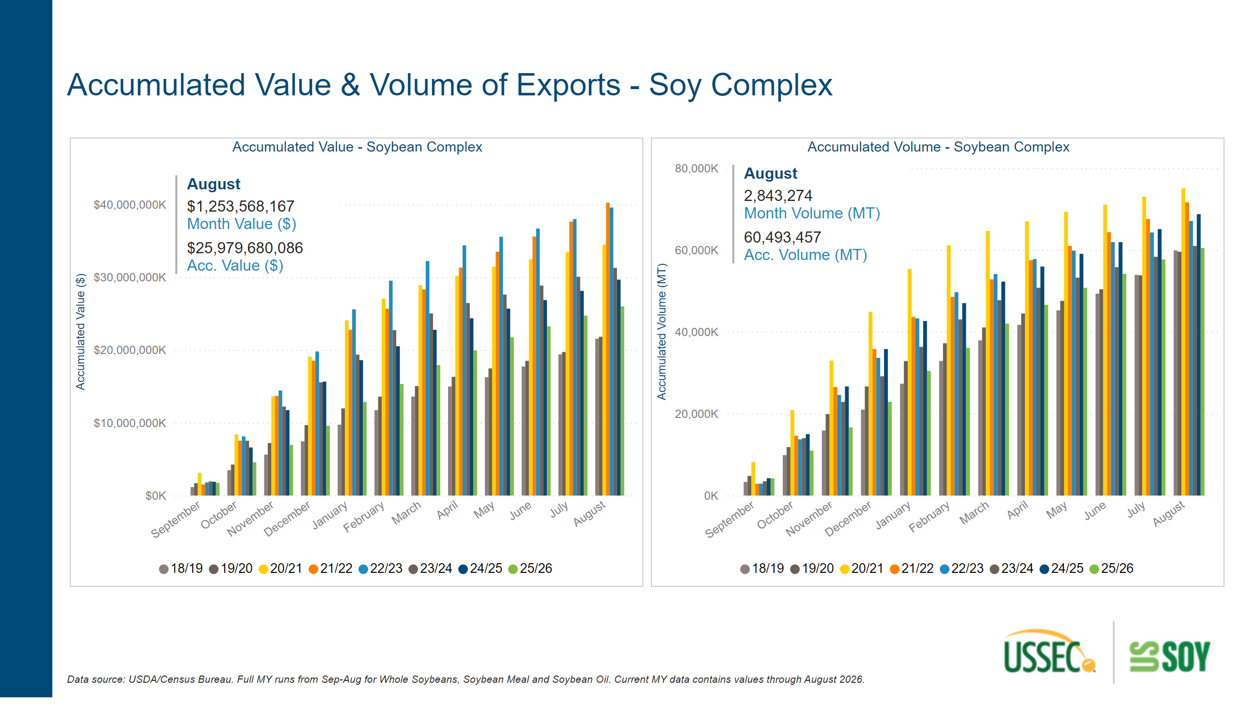
Acc. Exports to World - Complex
Notes:
slicer
No alt text provided
textbox
No alt text provided
multiRowCard
No alt text provided
multiRowCard
No alt text provided
Accumulated Volume - Soybean Complex
No alt text provided
textbox
No alt text provided
Accumulated Value - Soybean Complex
No alt text provided

Slide 15
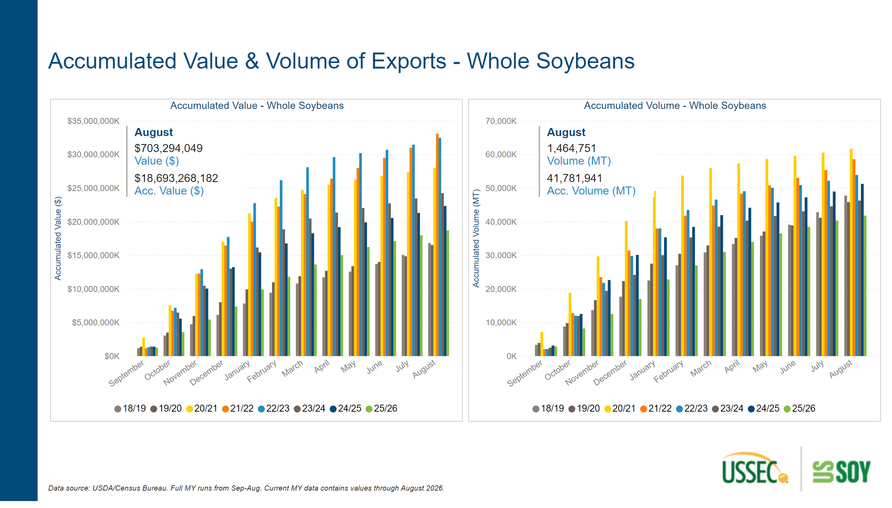
Acc. Exports to World - SB
Notes:
multiRowCard
No alt text provided
multiRowCard
No alt text provided
textbox
No alt text provided
textbox
No alt text provided
Accumulated Volume - Whole Soybeans
No alt text provided
Accumulated Value - Whole Soybeans
No alt text provided

Slide 16
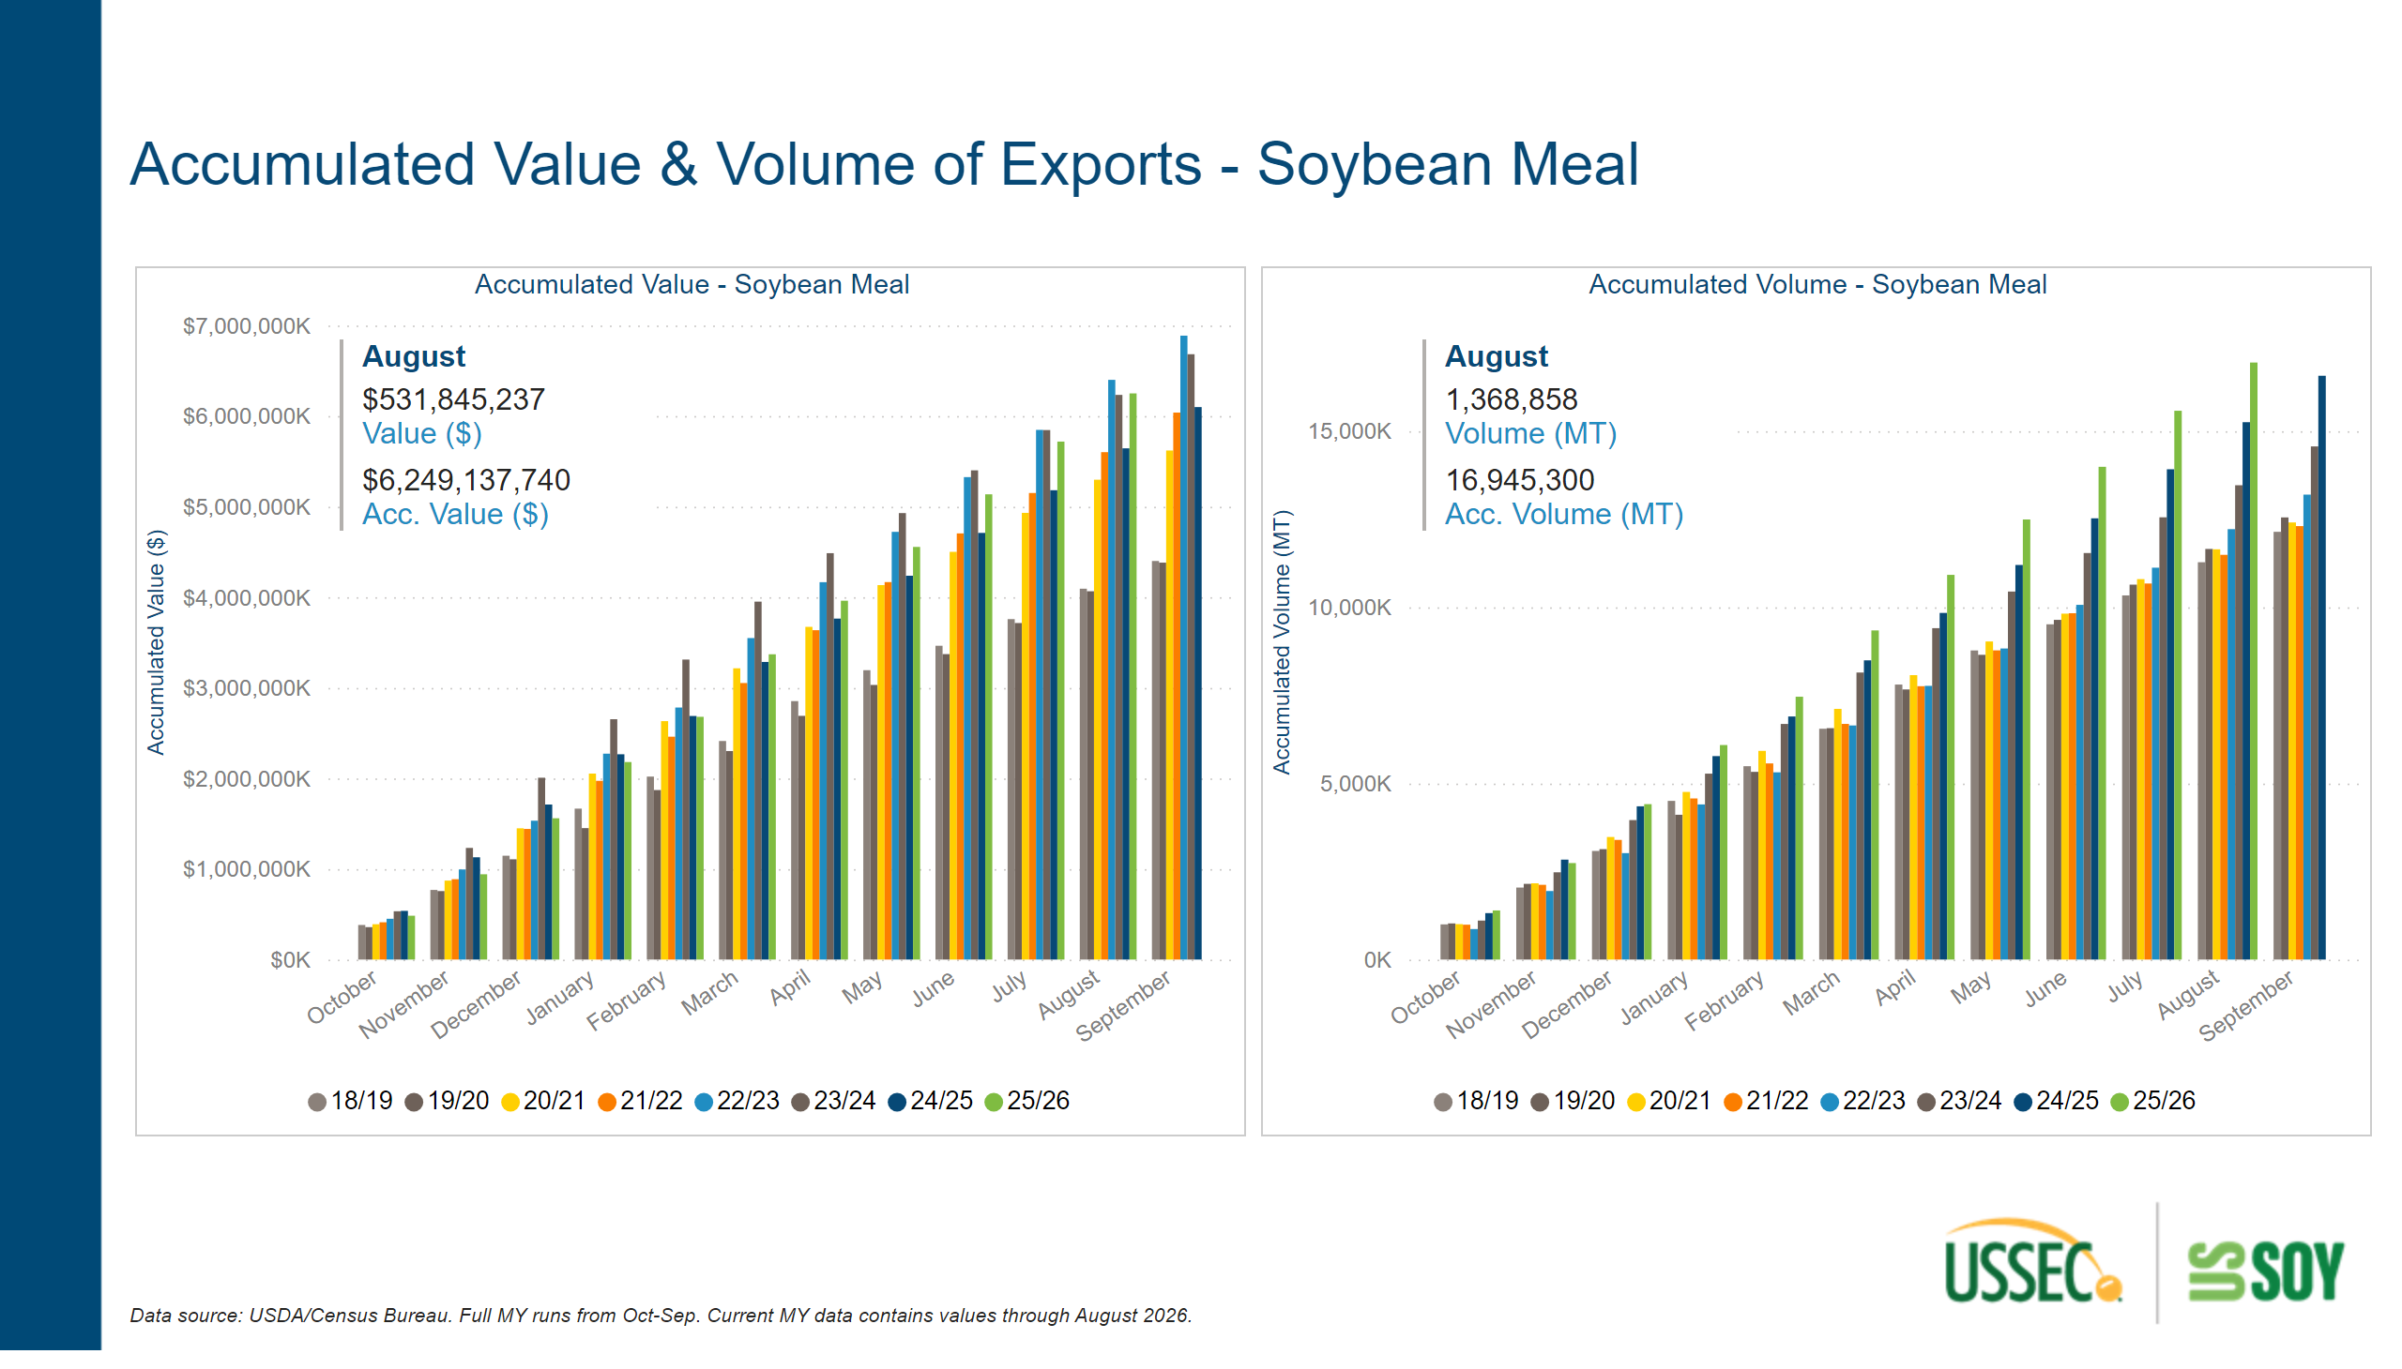
Acc. Exports to World - SBM
Notes:
multiRowCard
No alt text provided
textbox
No alt text provided
Accumulated Volume - Soybean Meal
No alt text provided
textbox
No alt text provided
Accumulated Value - Soybean Meal
No alt text provided
multiRowCard
No alt text provided

Slide 17
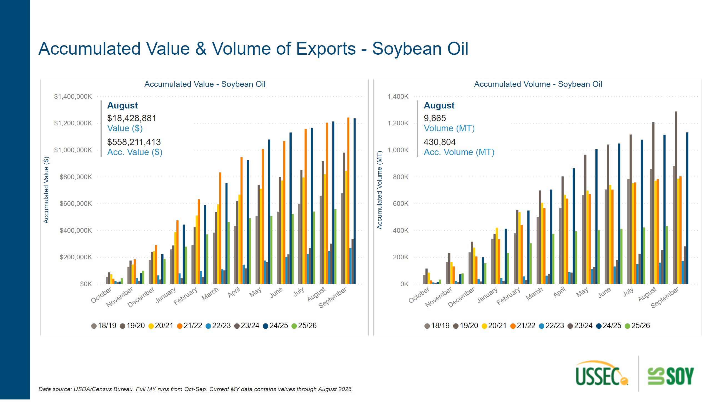
Acc. Exports to World - SBO
Notes:
Accumulated Volume - Soybean Oil
No alt text provided
Accumulated Value - Soybean Oil
No alt text provided
multiRowCard
No alt text provided
textbox
No alt text provided
multiRowCard
No alt text provided
textbox
No alt text provided

Slide 18
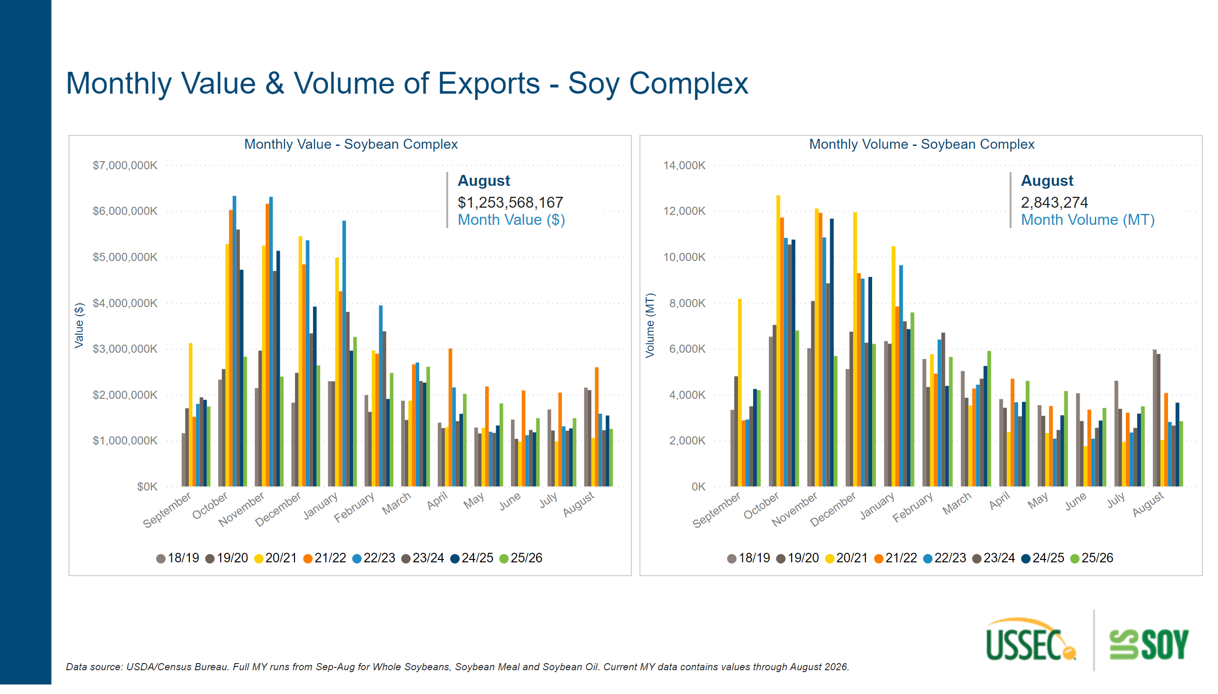
Monthly Exports to World - Complex
Notes:
Monthly Volume - Soybean Complex
No alt text provided
textbox
No alt text provided
slicer
No alt text provided
Monthly Value - Soybean Complex
No alt text provided
multiRowCard
No alt text provided
multiRowCard
No alt text provided
textbox
No alt text provided

Slide 19
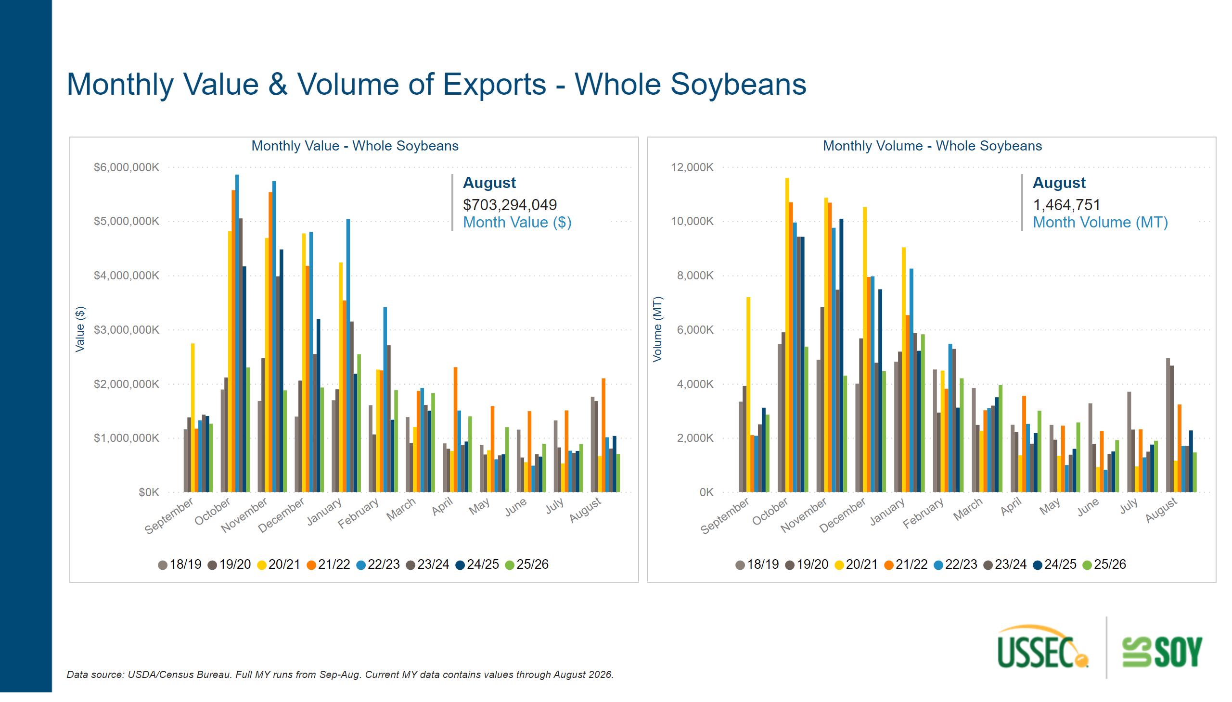
Monthly Exports to World - SB
Notes:
slicer
No alt text provided
multiRowCard
No alt text provided
textbox
No alt text provided
Monthly Volume - Whole Soybeans
No alt text provided
textbox
No alt text provided
multiRowCard
No alt text provided
Monthly Value - Whole Soybeans
No alt text provided

Slide 20
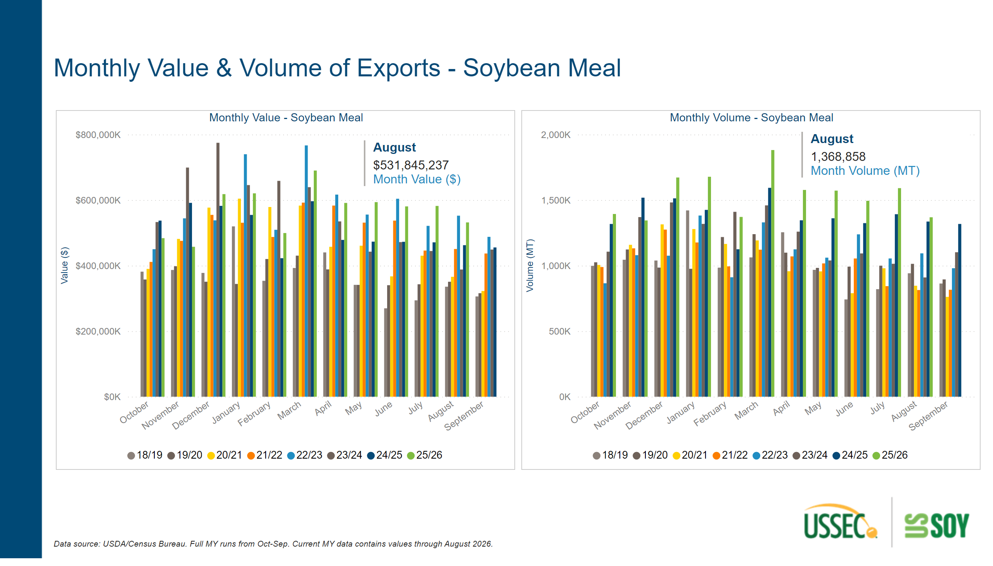
Monthly Exports to World - SBM
Notes:
Monthly Value - Soybean Meal
No alt text provided
multiRowCard
No alt text provided
Monthly Volume - Soybean Meal
No alt text provided
textbox
No alt text provided
textbox
No alt text provided
slicer
No alt text provided
multiRowCard
No alt text provided

Slide 21
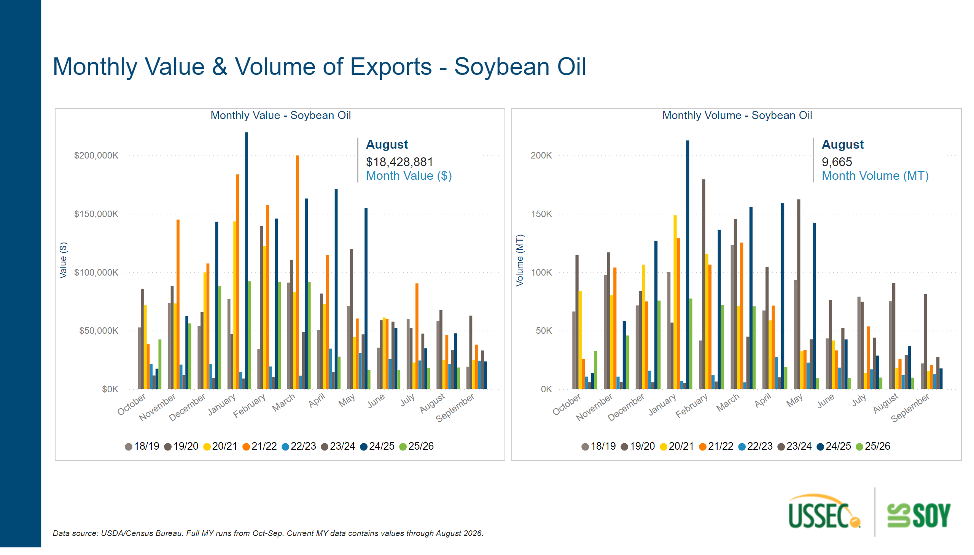
Monthly Exports to World - SBO
Notes:
multiRowCard
No alt text provided
Monthly Volume - Soybean Oil
No alt text provided
textbox
No alt text provided
multiRowCard
No alt text provided
slicer
No alt text provided
Monthly Value - Soybean Oil
No alt text provided
textbox
No alt text provided

Slide 22

ExportsbyDestCover
Notes:
textbox
No alt text provided

Slide 23
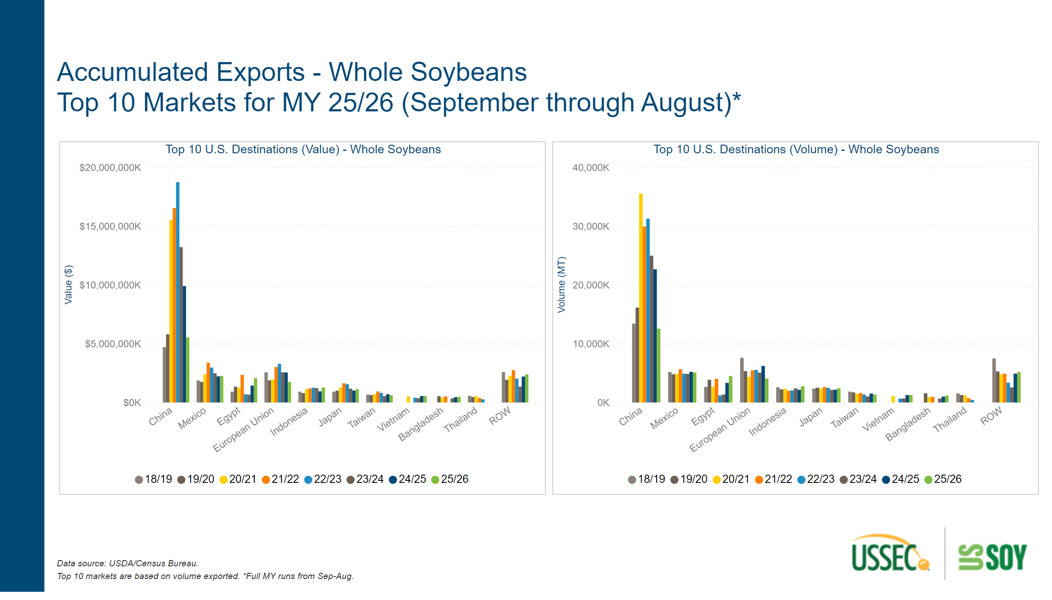
Acc. Exports by Destination - SB
Notes:
Top 10 U.S. Destinations (Volume) - Whole Soybeans
No alt text provided
Top 10 U.S. Destinations (Value) - Whole Soybeans
No alt text provided
textbox
No alt text provided
textbox
No alt text provided

Slide 24
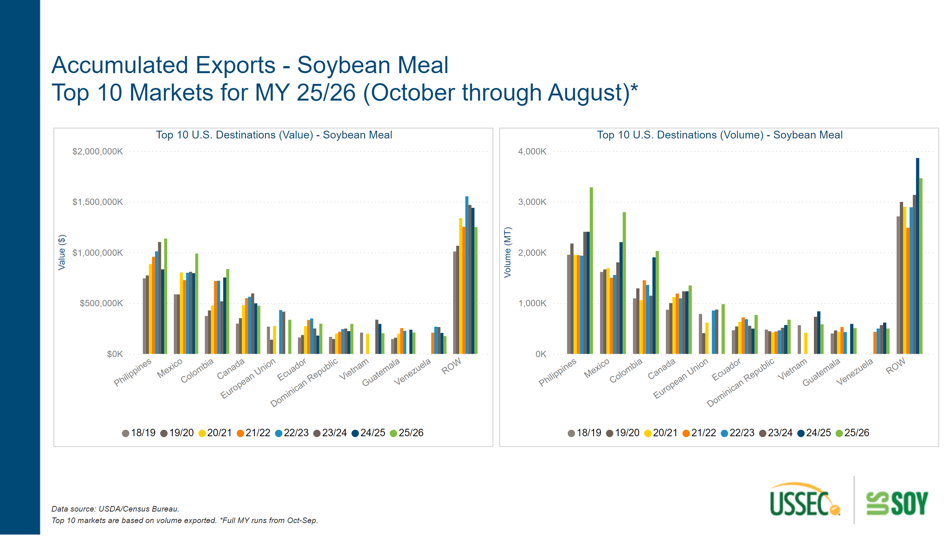
Acc. Exports by Destination - SBM
Notes:
Top 10 U.S. Destinations (Volume) - Soybean Meal
No alt text provided
textbox
No alt text provided
textbox
No alt text provided
Top 10 U.S. Destinations (Value) - Soybean Meal
No alt text provided

Slide 25
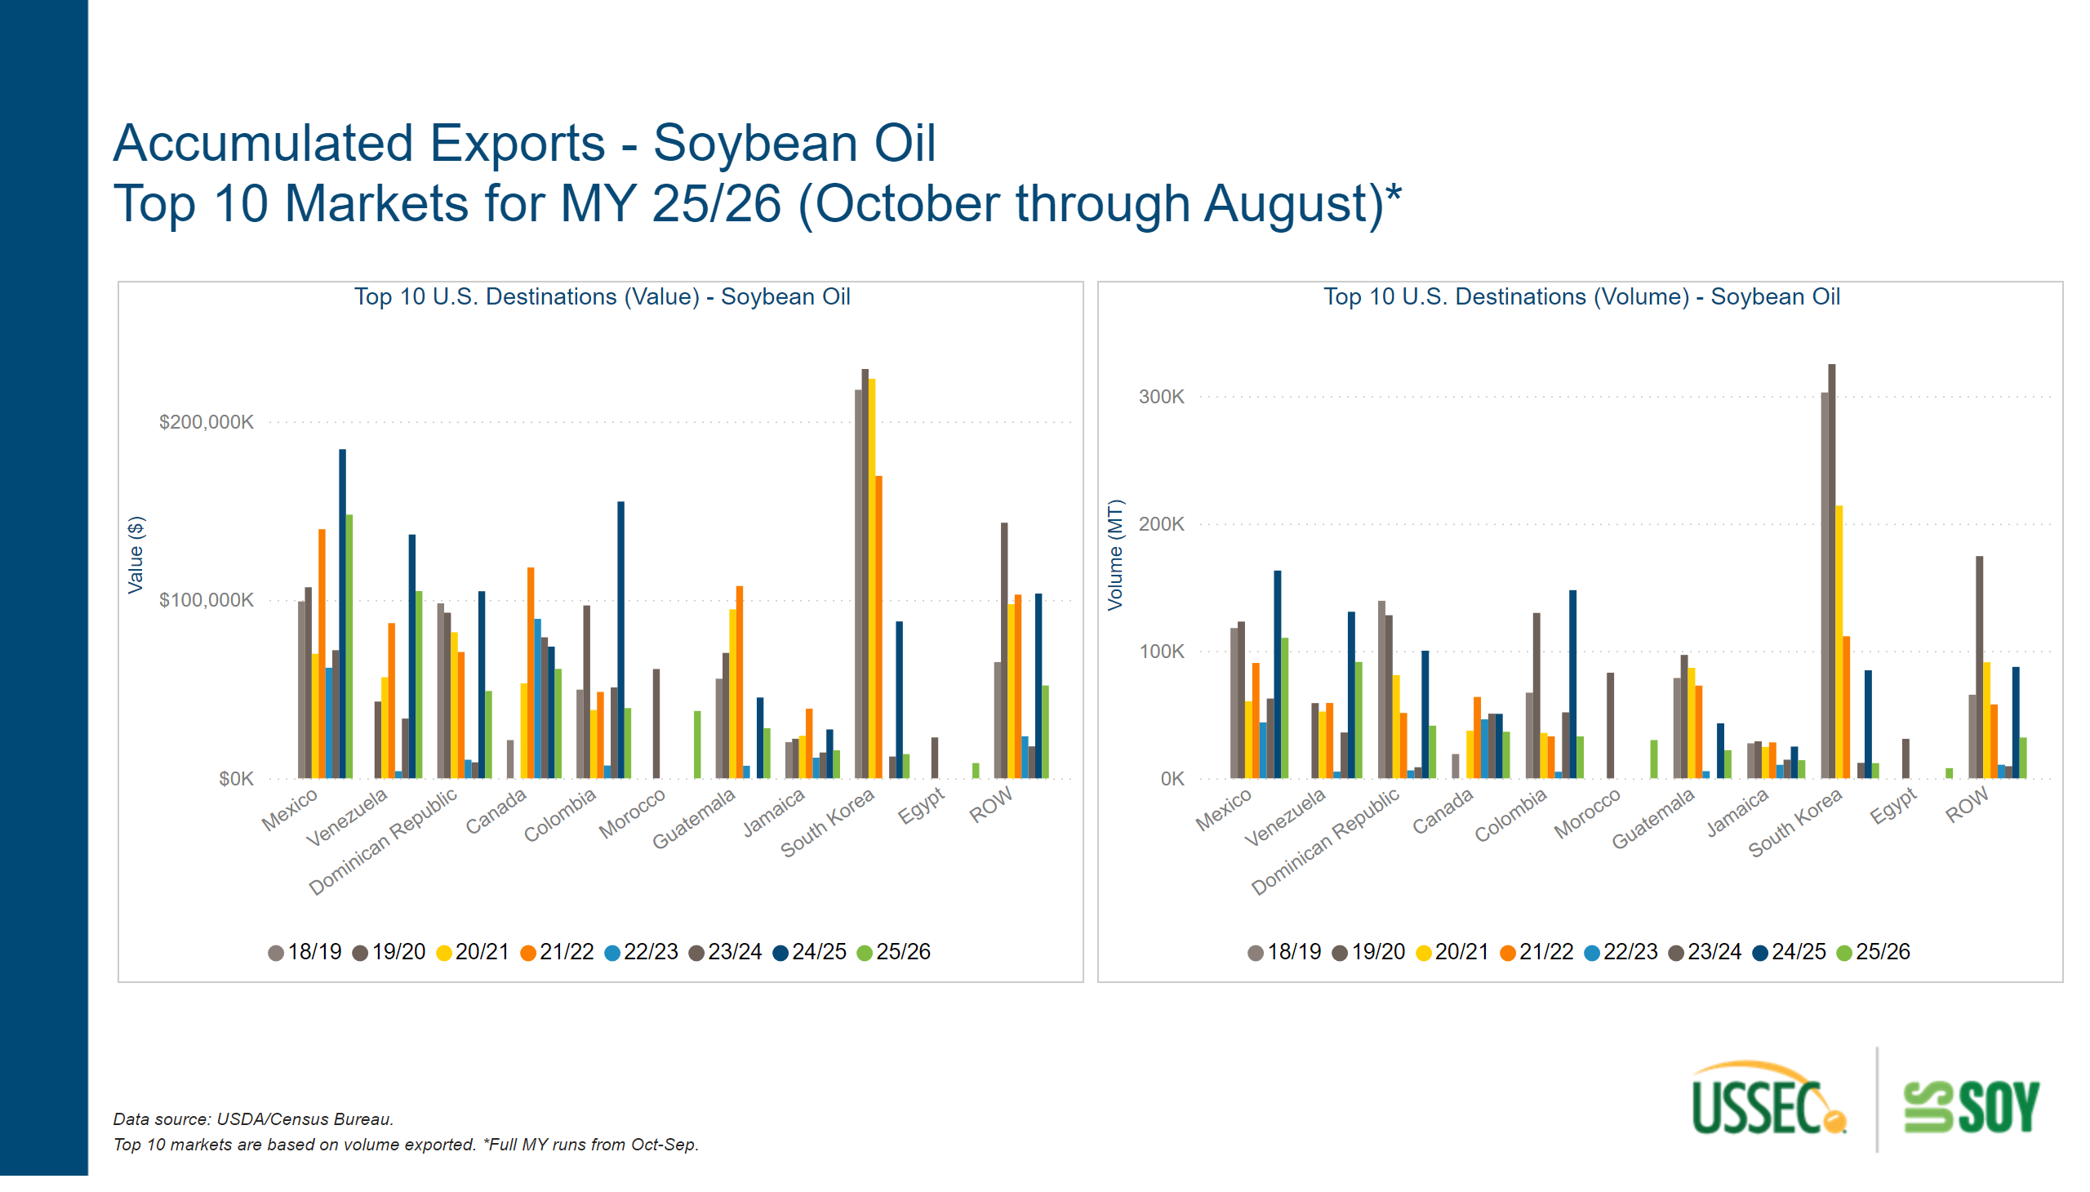
Acc. Exports by Destination - SBO
Notes:
textbox
No alt text provided
textbox
No alt text provided
Top 10 U.S. Destinations (Value) - Soybean Oil
No alt text provided
Top 10 U.S. Destinations (Volume) - Soybean Oil
No alt text provided

Slide 26
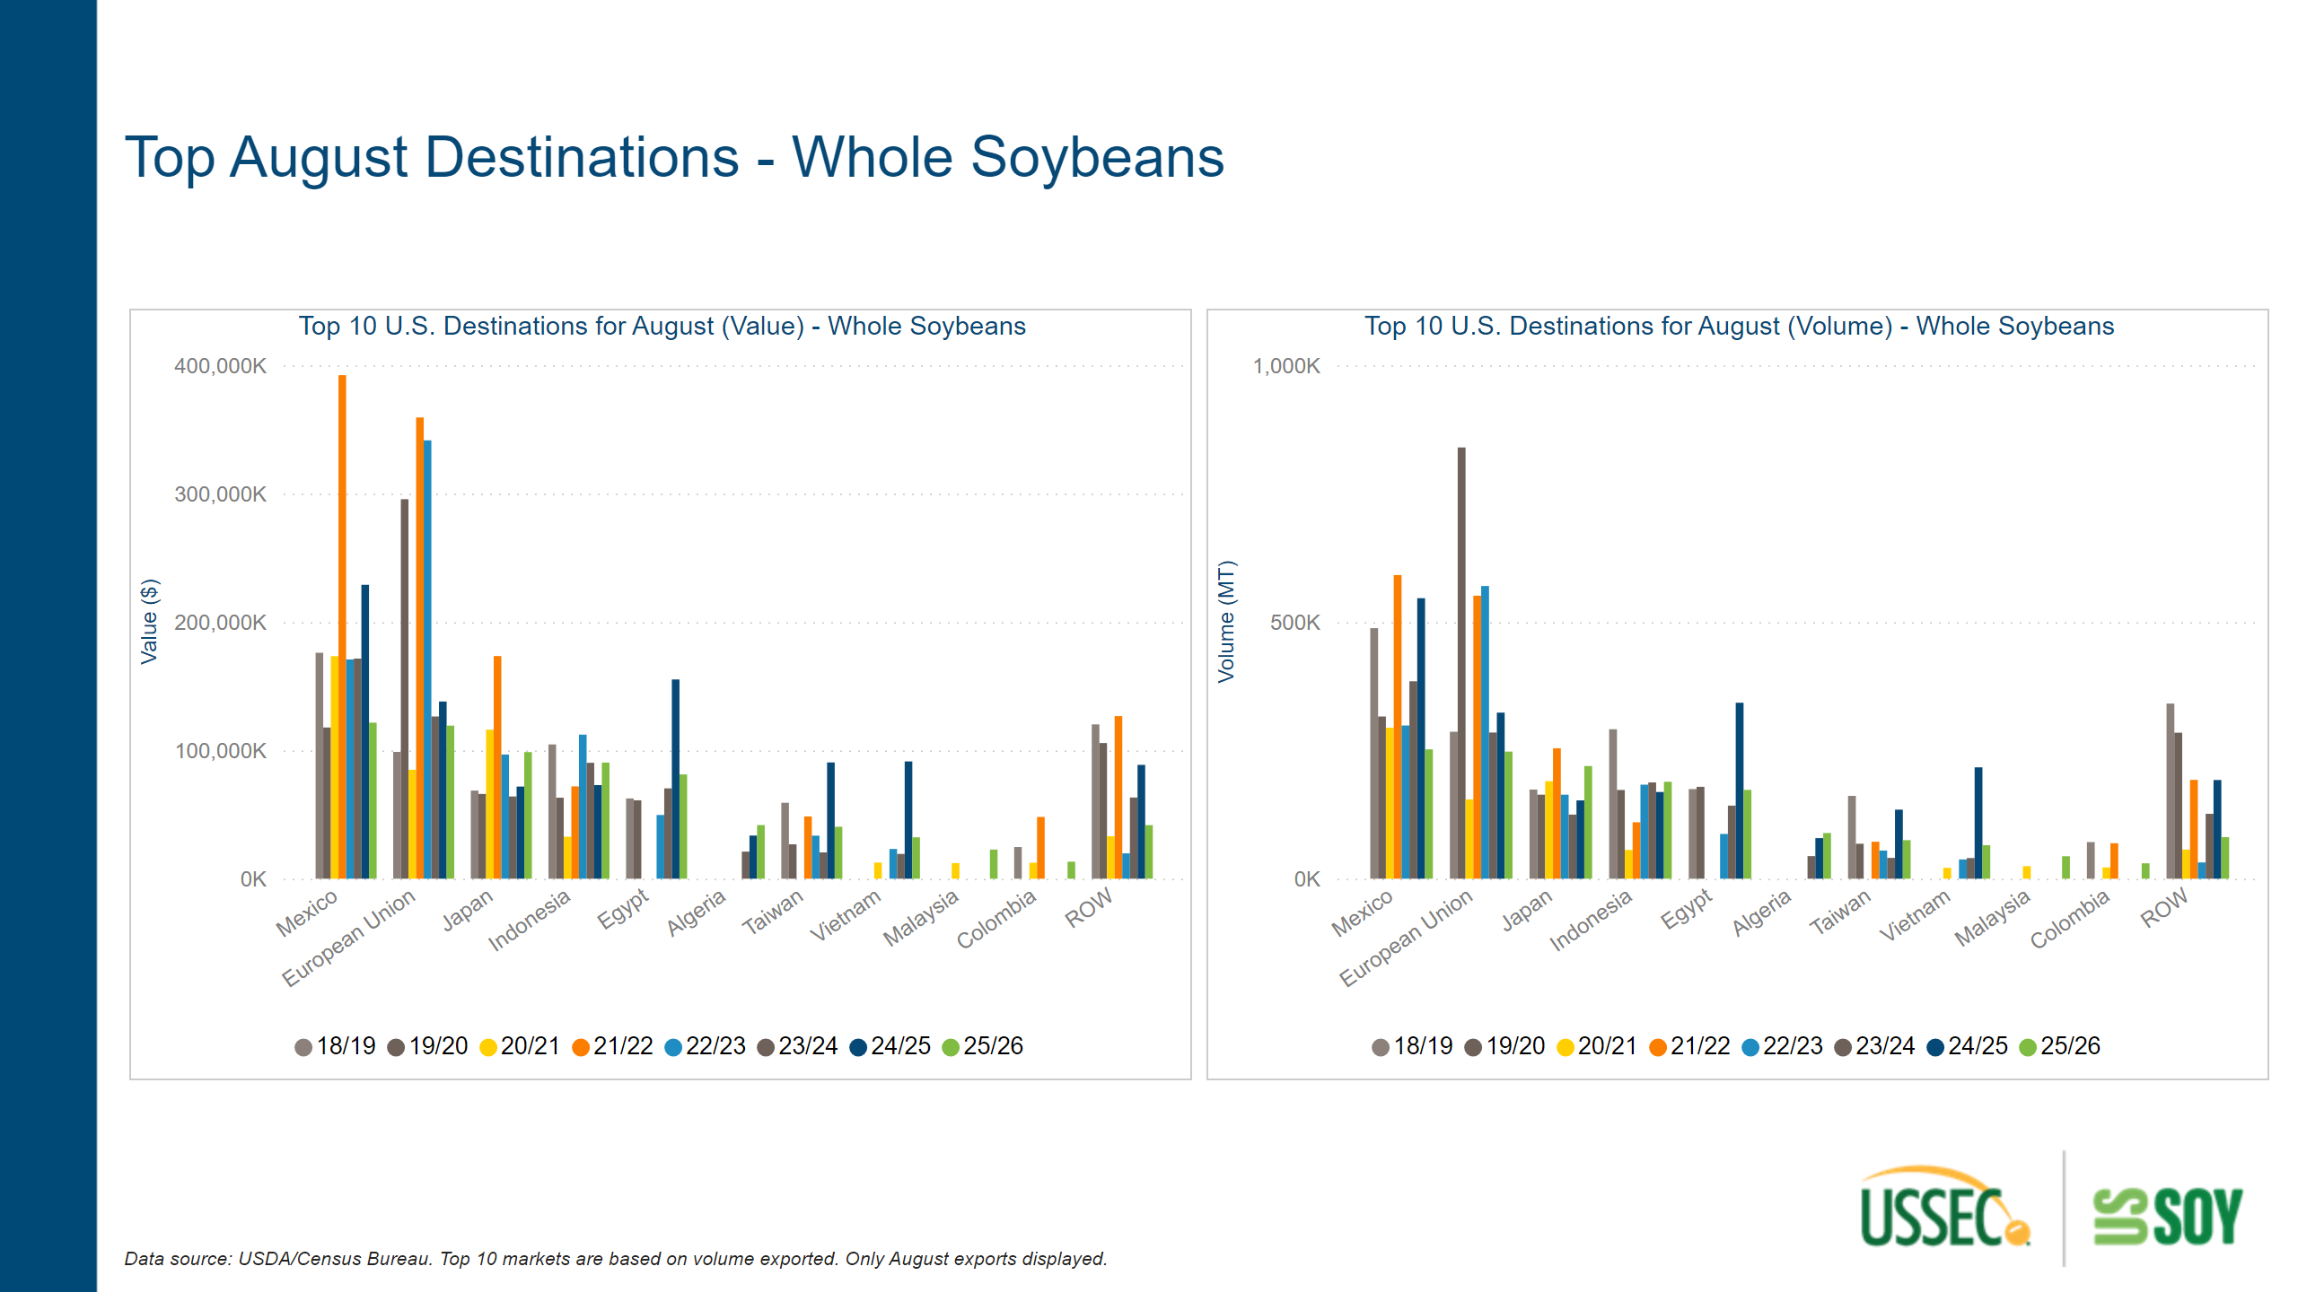
Top Destinations Current Month - SB
Notes:
Top 10 U.S. Destinations for August (Value) - Whole Soybeans
No alt text provided
textbox
No alt text provided
Top 10 U.S. Destinations for August (Volume) - Whole Soybeans
No alt text provided
textbox
No alt text provided

Slide 27
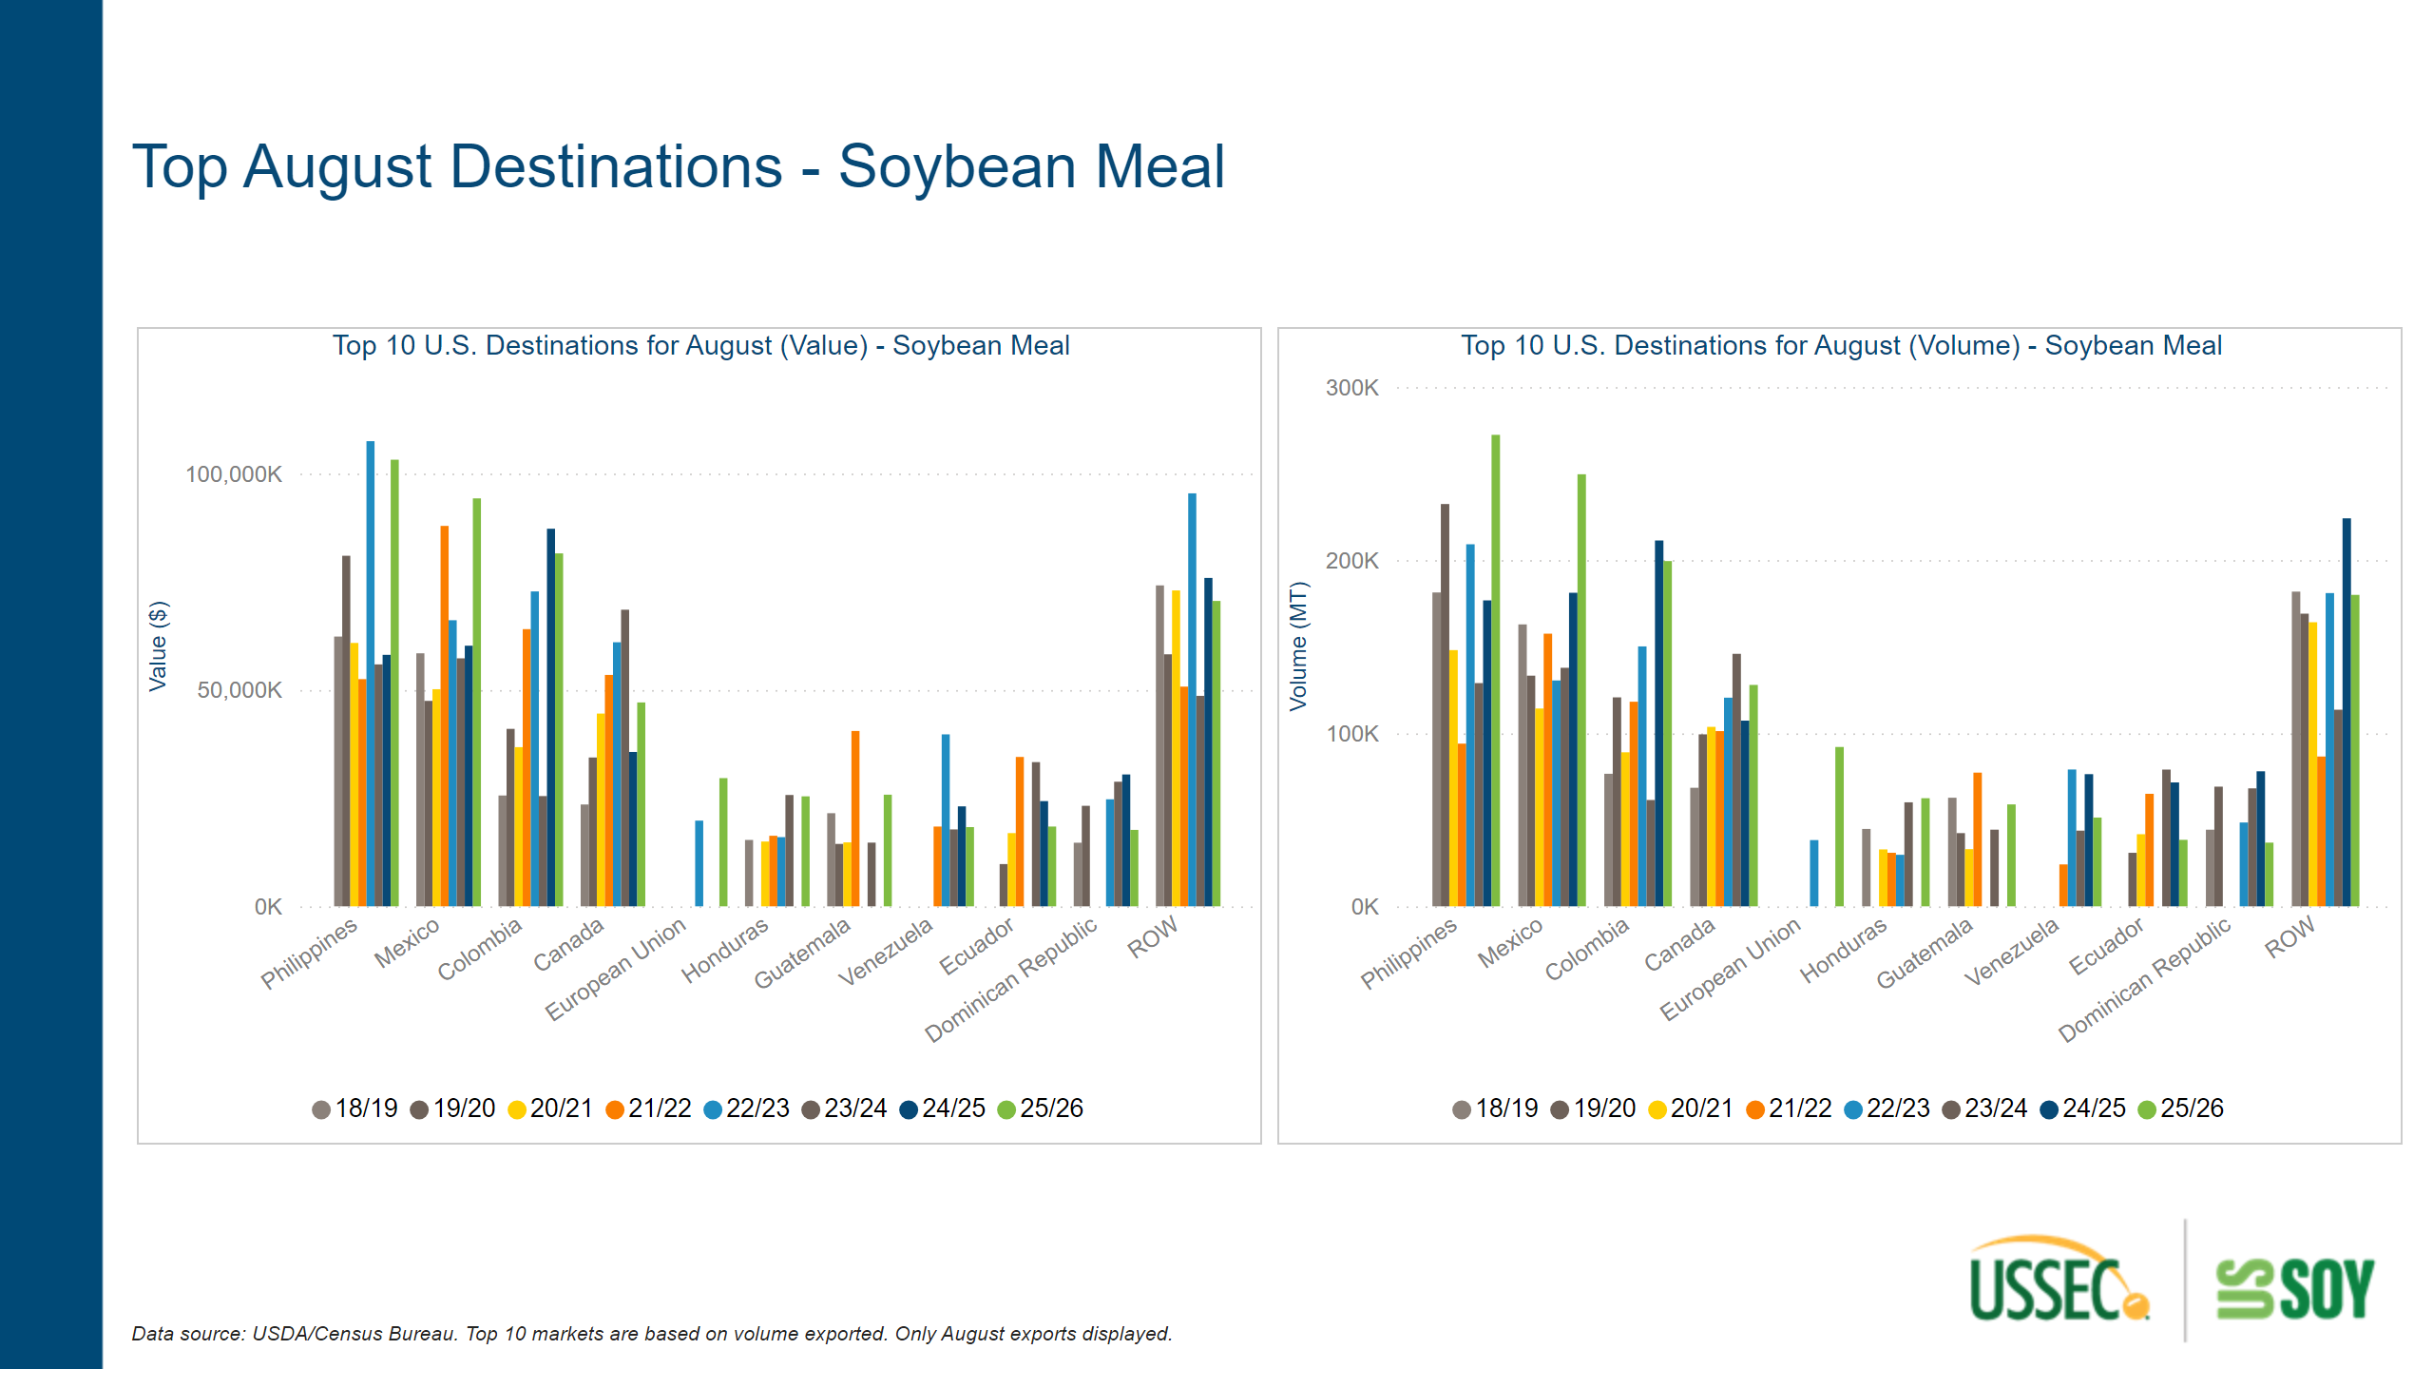
Top Destinations Current Month - SBM
Notes:
Top 10 U.S. Destinations for August (Volume) - Soybean Meal
No alt text provided
textbox
No alt text provided
Top 10 U.S. Destinations for August (Value) - Soybean Meal
No alt text provided
textbox
No alt text provided

Slide 28
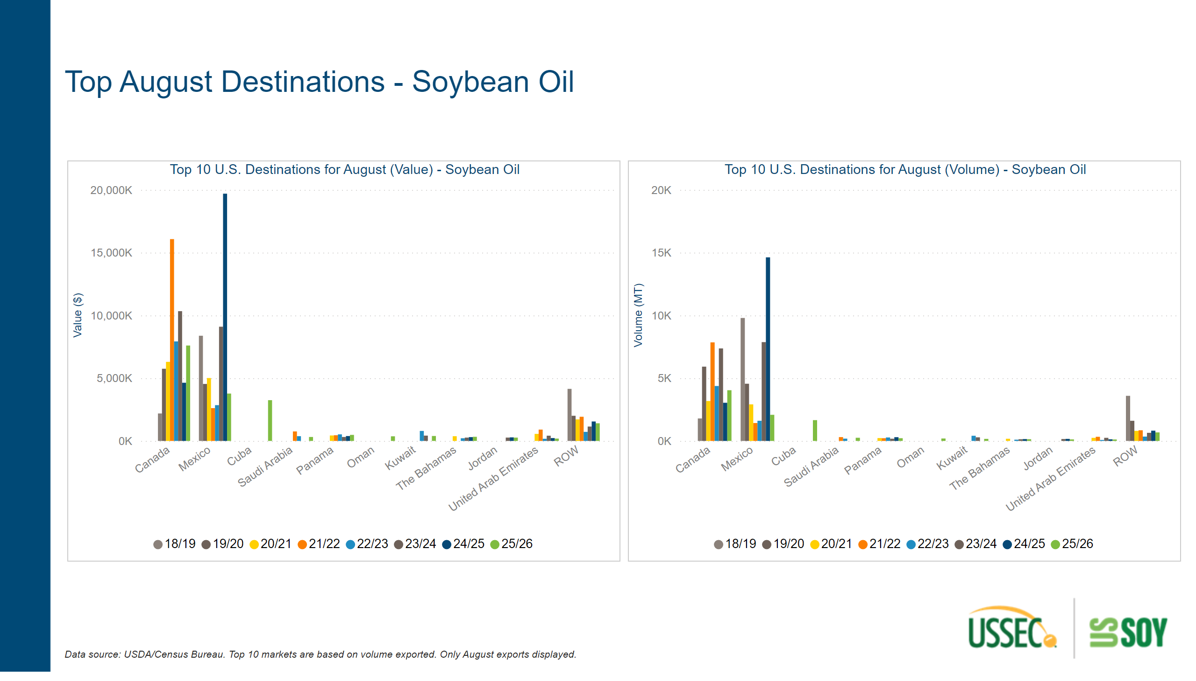
Top Destinations Current Month - SBO
Notes:
textbox
No alt text provided
Top 10 U.S. Destinations for August (Volume) - Soybean Oil
No alt text provided
textbox
No alt text provided
Top 10 U.S. Destinations for August (Value) - Soybean Oil
No alt text provided

Slide 29
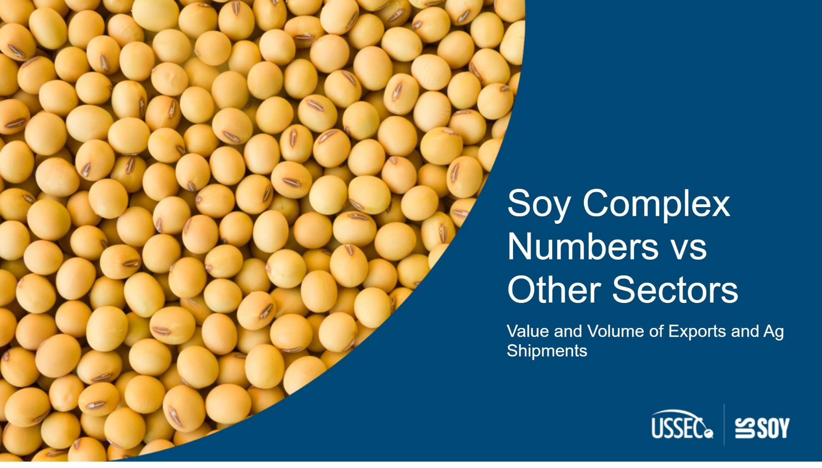
SoySectorvsOthers Cover
Notes:
textbox
No alt text provided

Slide 30
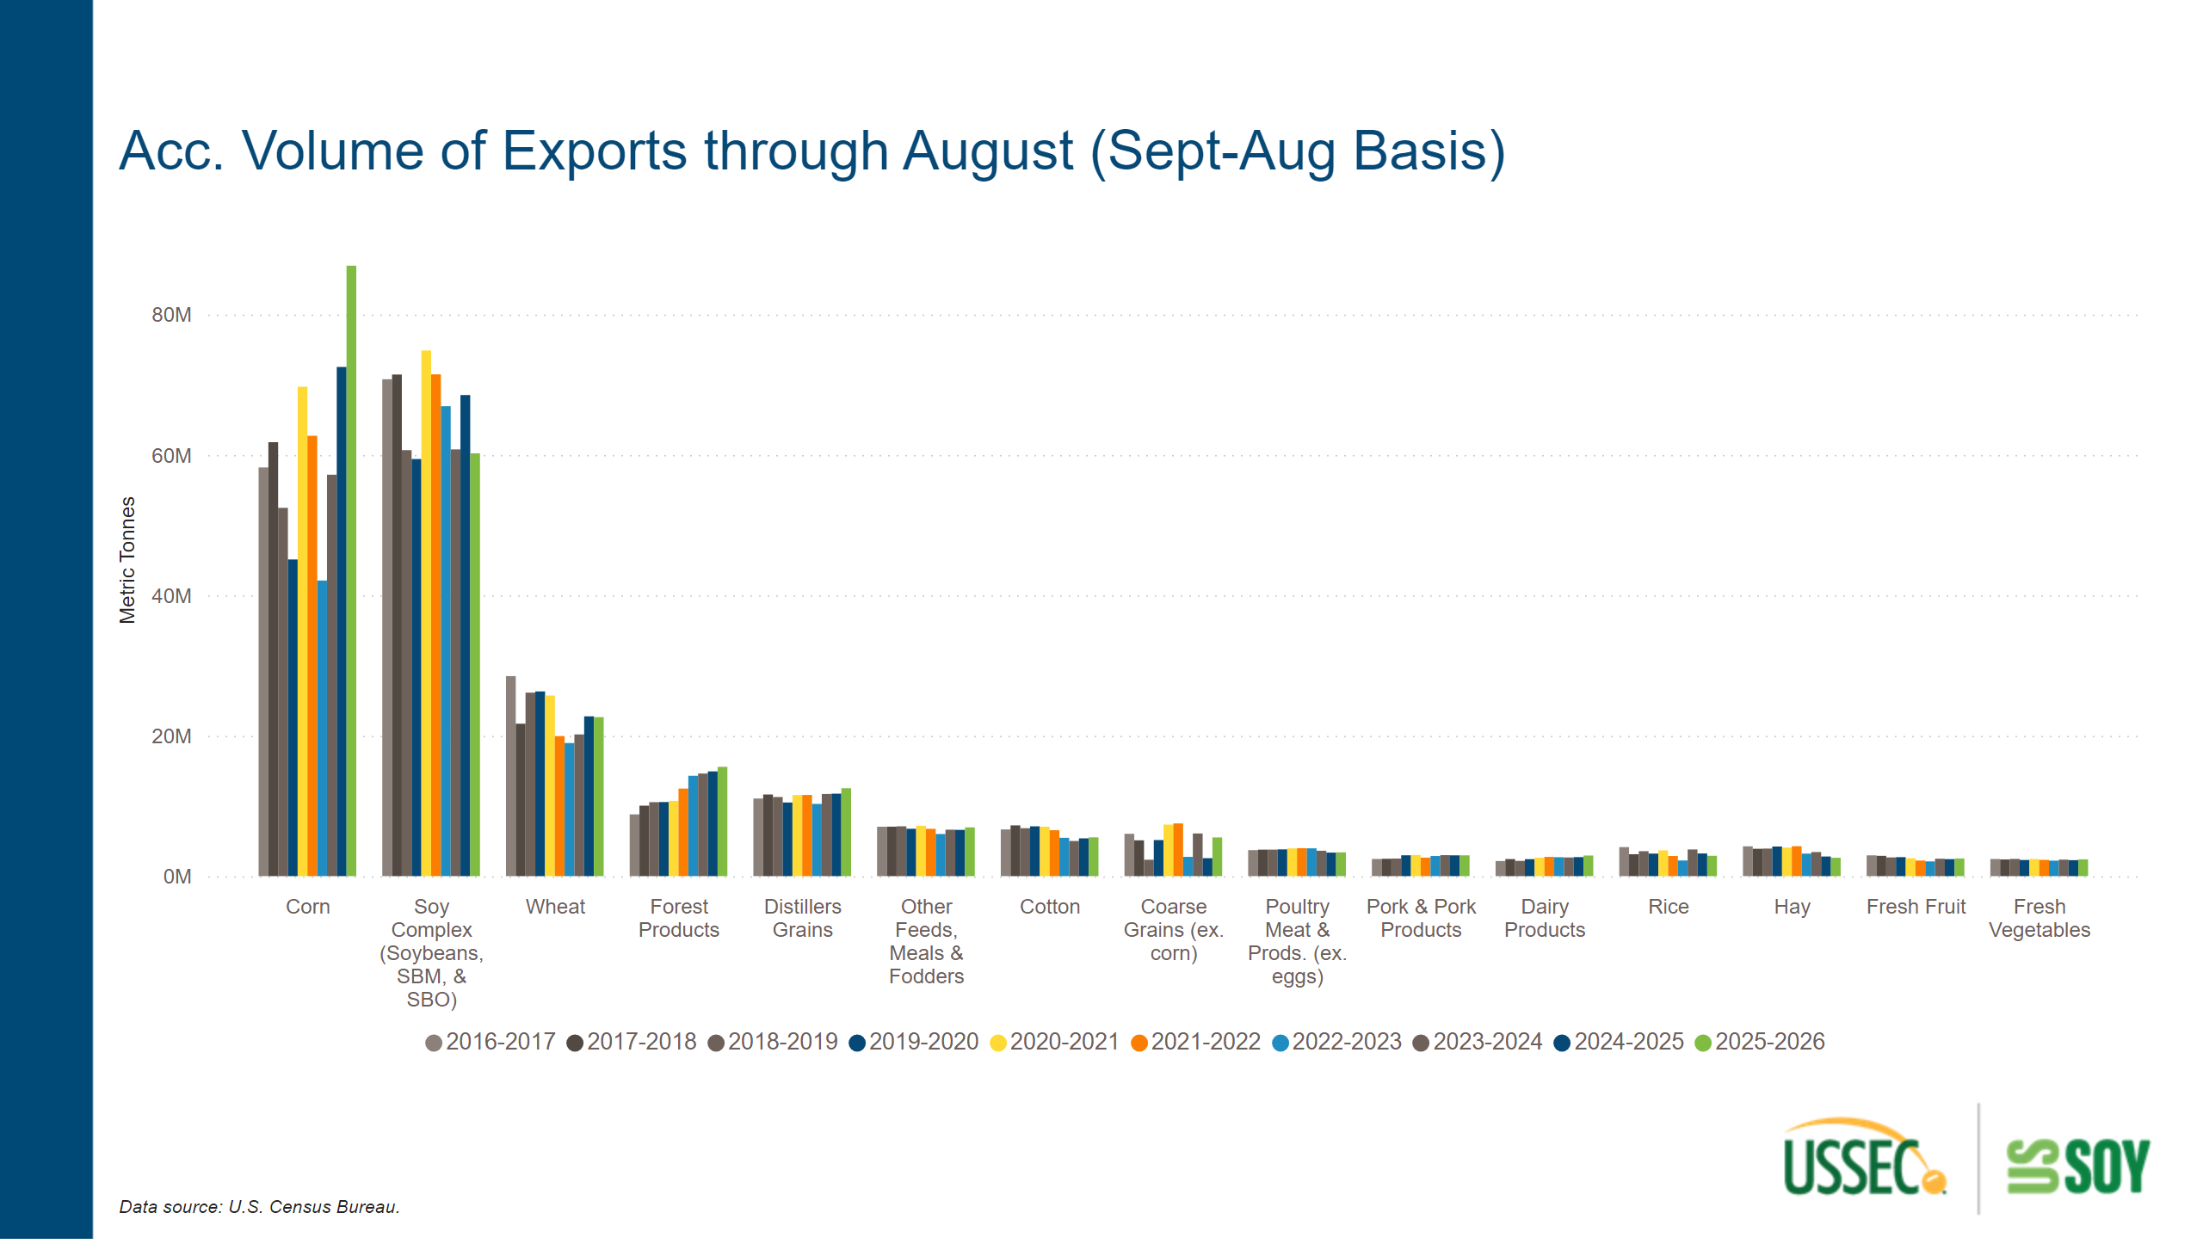
VOS Compare Volume
Notes:
clusteredColumnChart
No alt text provided
textbox
No alt text provided
textbox
No alt text provided

Slide 31
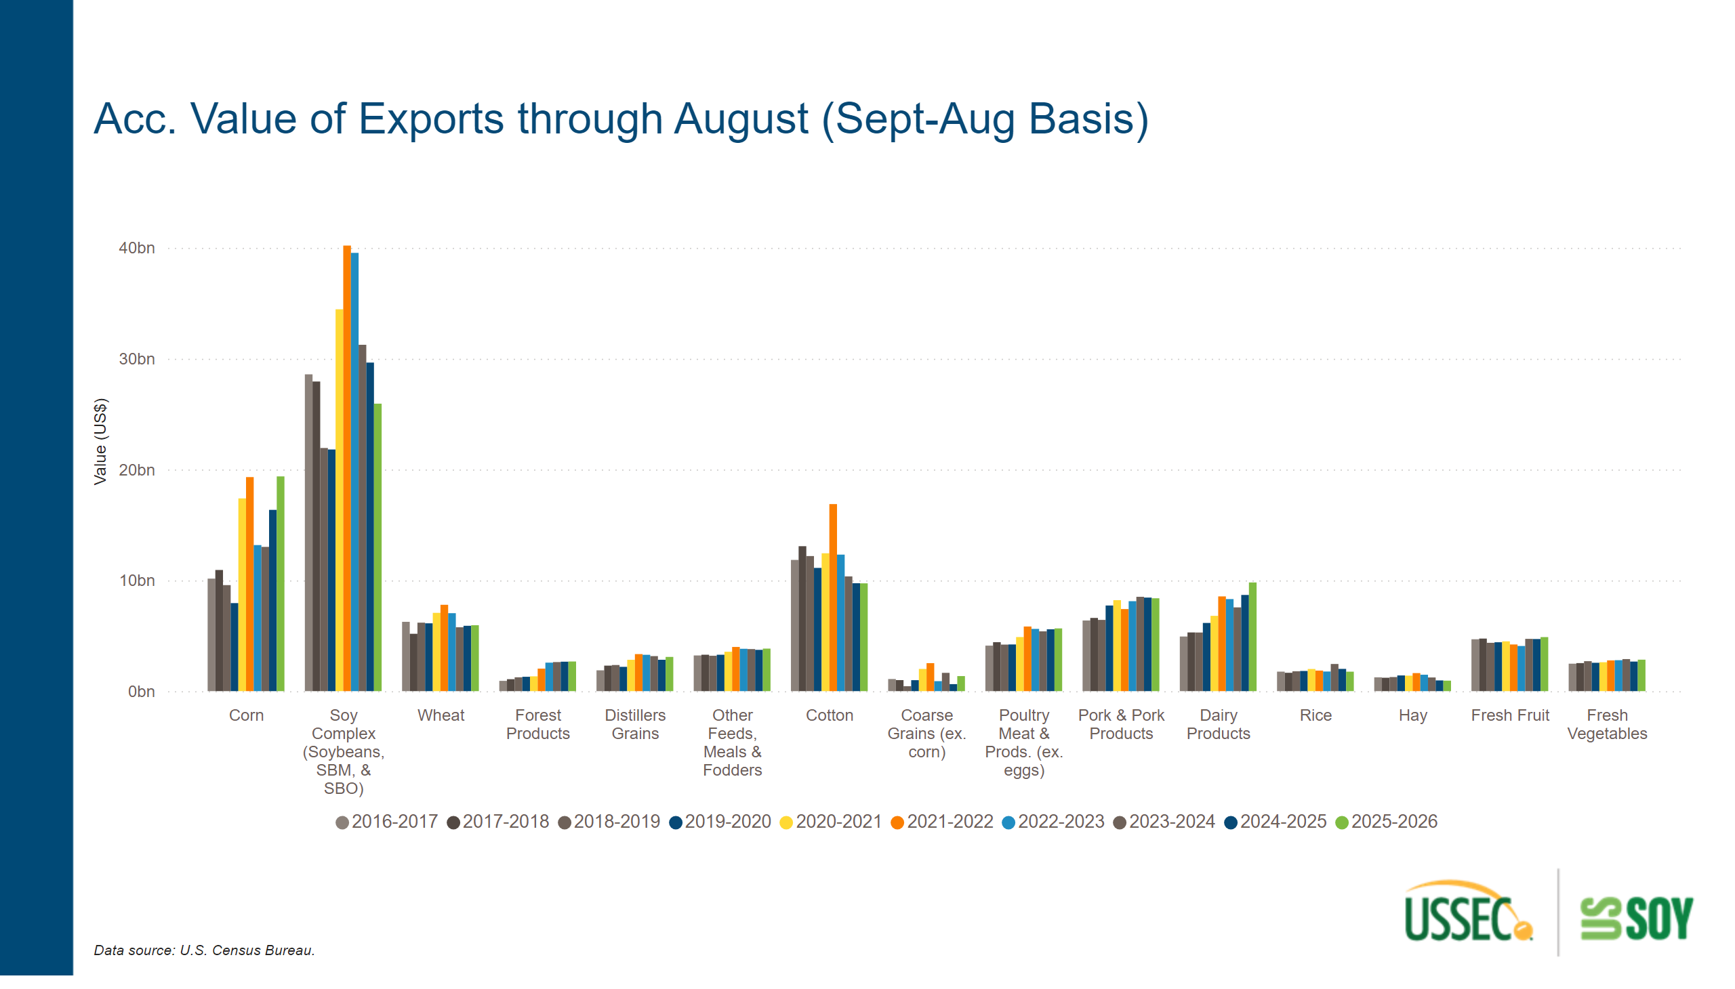
VOS Compare Value
Notes:
clusteredColumnChart
No alt text provided
textbox
No alt text provided
textbox
No alt text provided

Slide 32
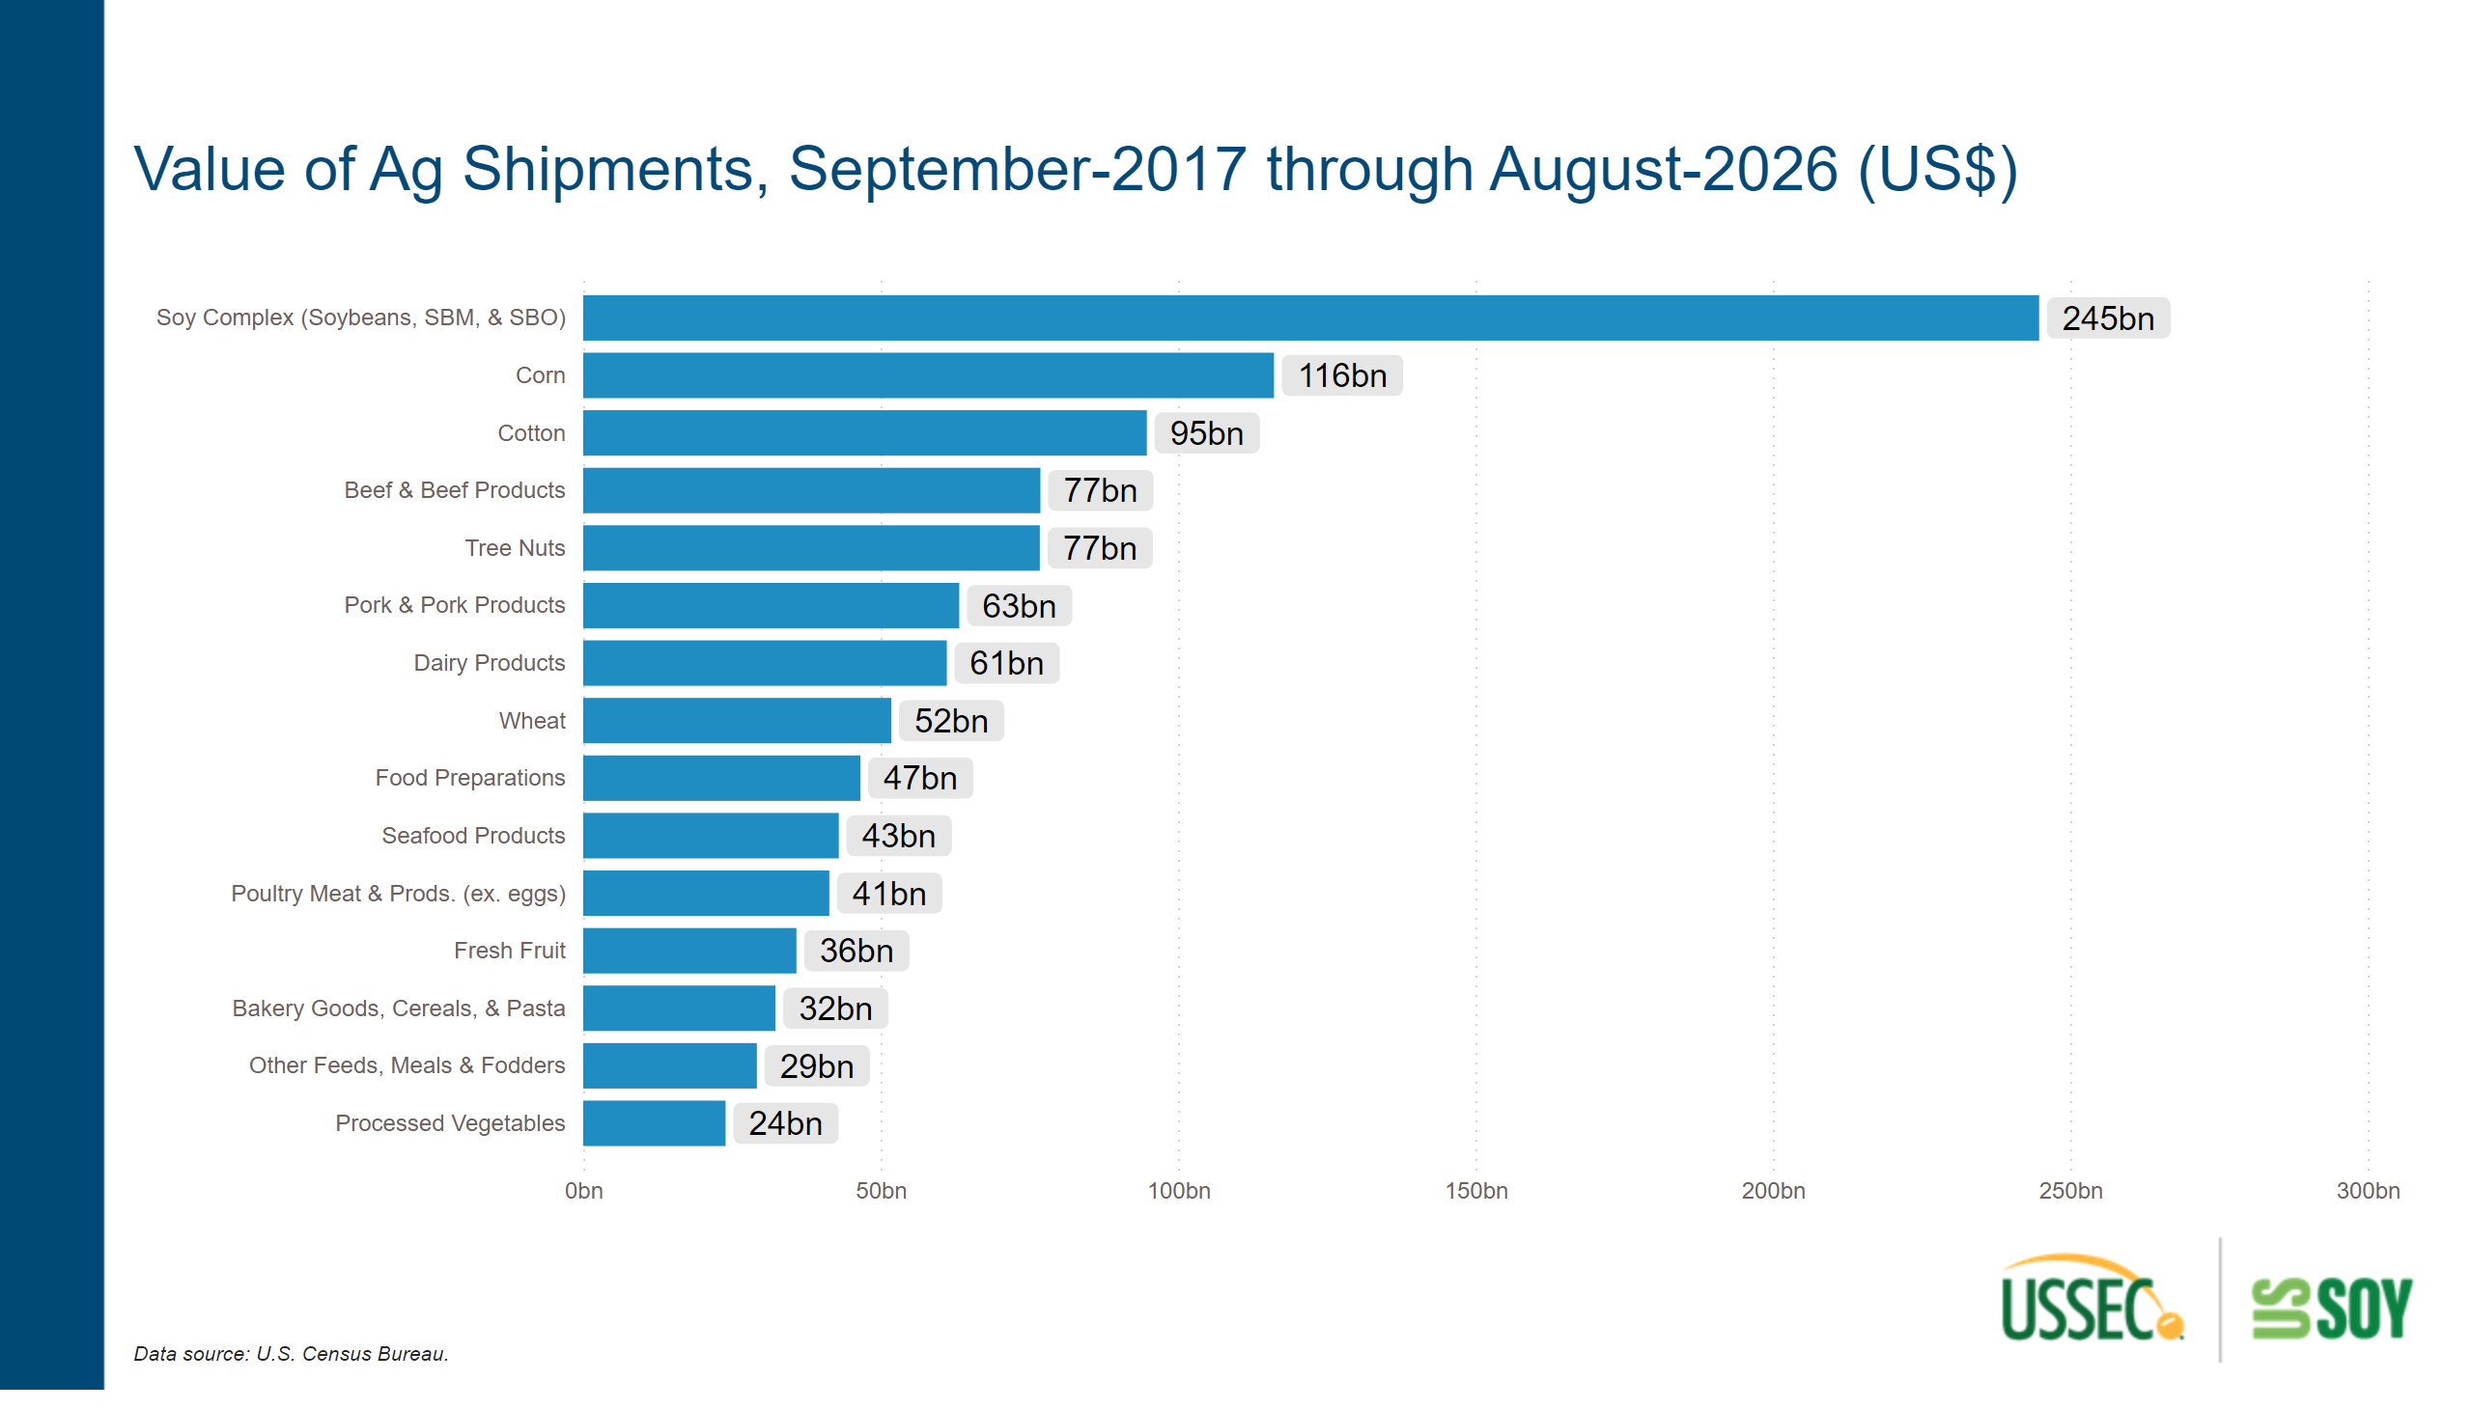
AgShip Value
Notes:
($ Billions)
No alt text provided
textbox
No alt text provided
textbox
No alt text provided

Slide 33
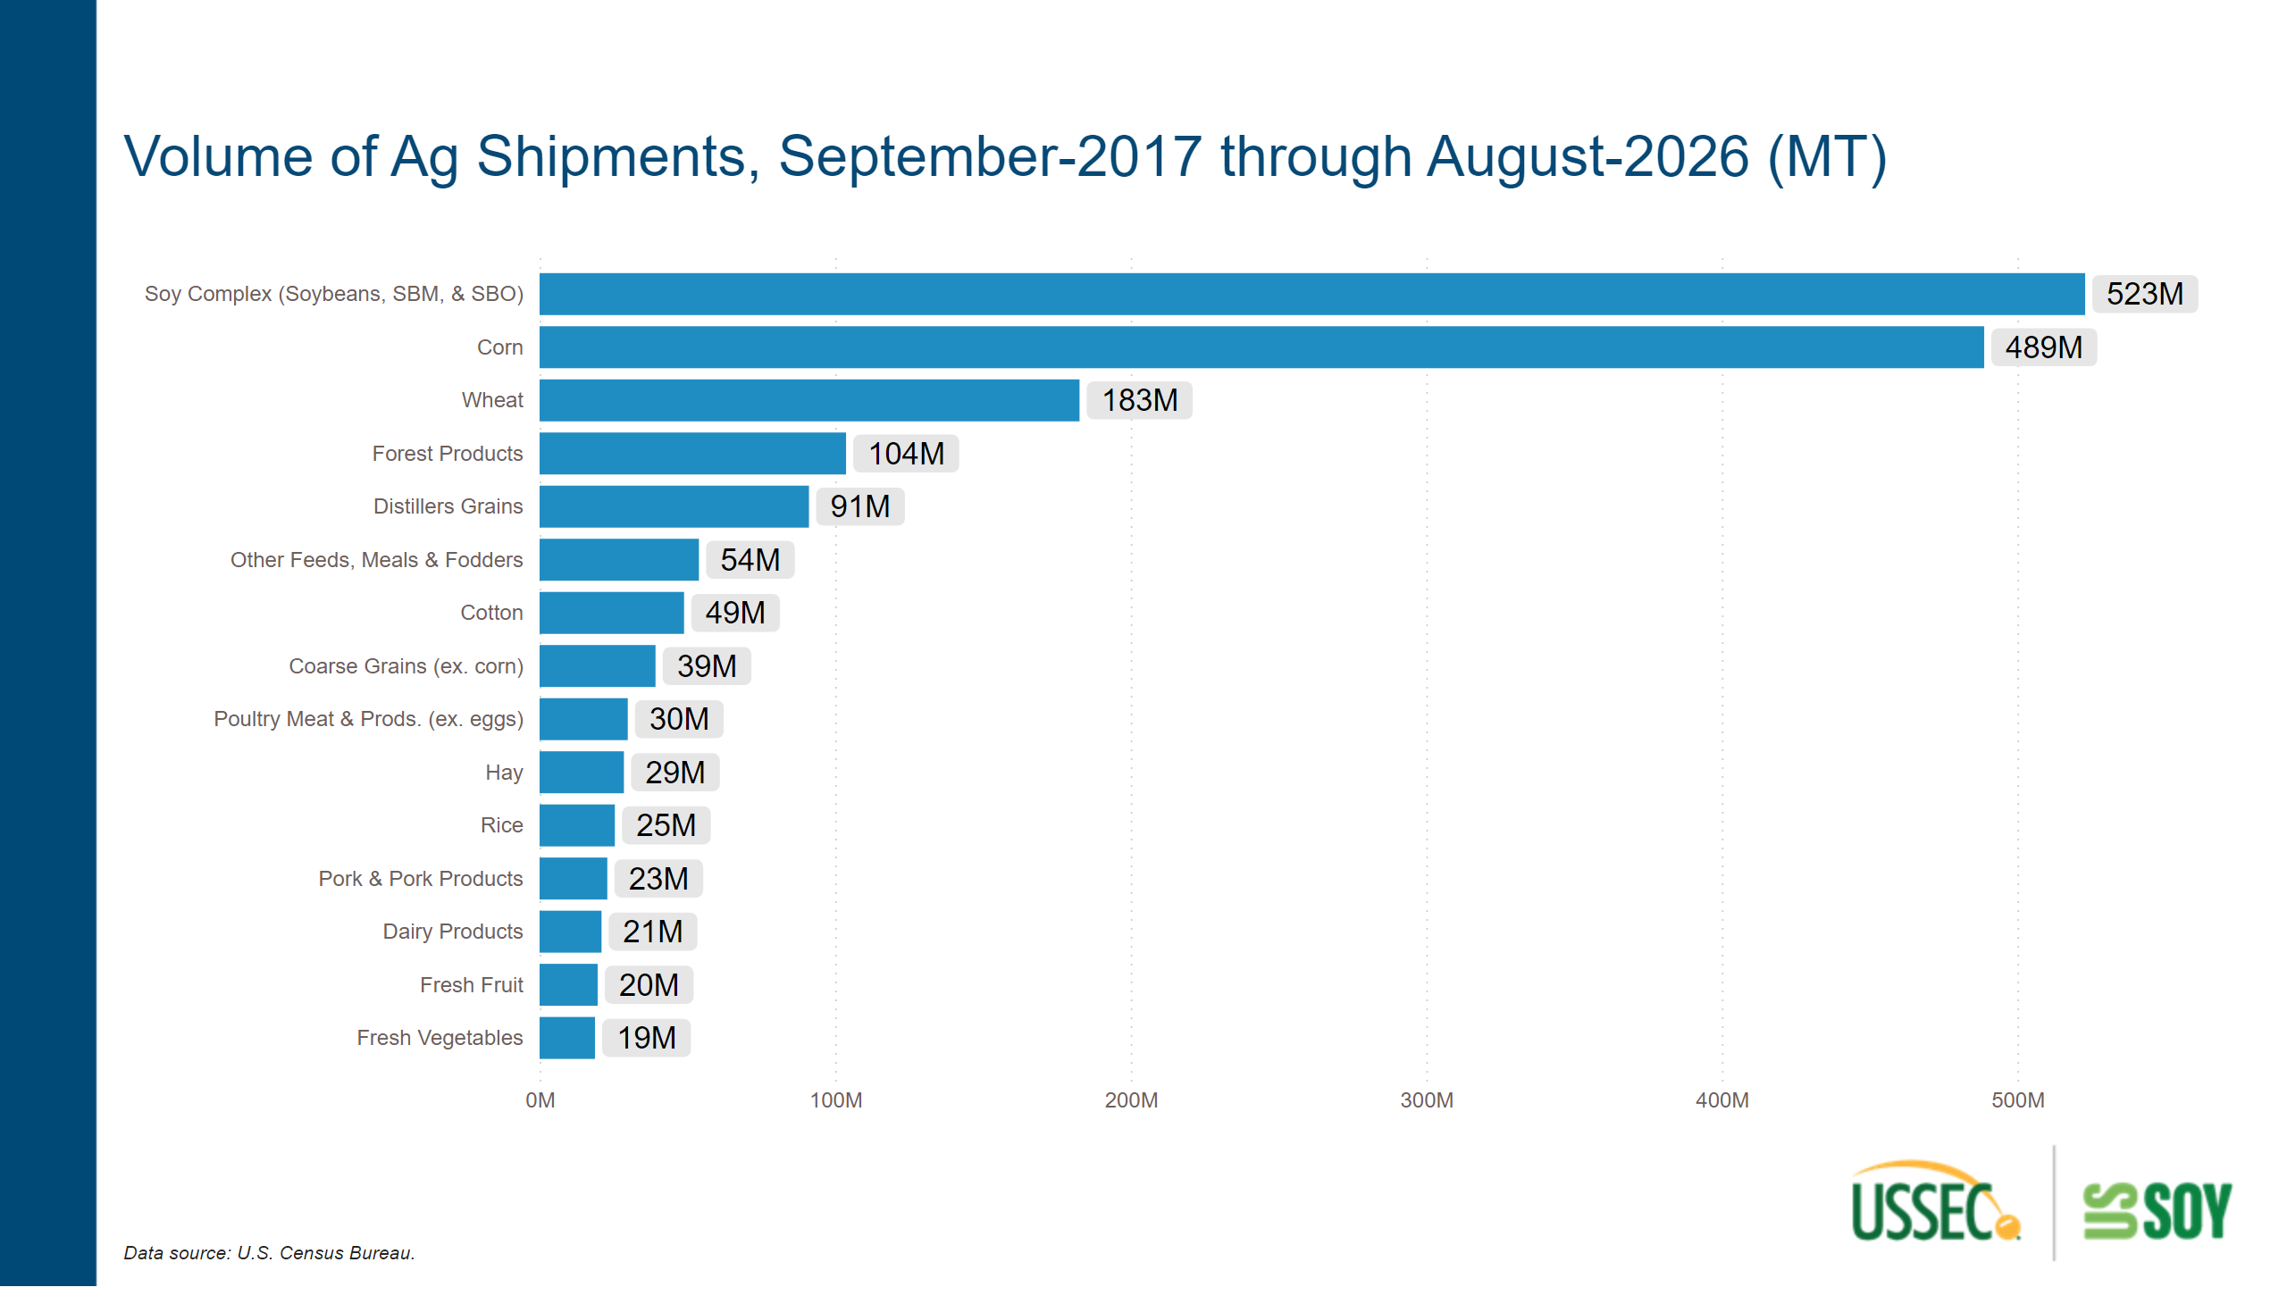
AgShip Volume
Notes:
textbox
No alt text provided
textbox
No alt text provided
($ Billions)
No alt text provided

